Slide 1
REGULATION OF DANCING and Music IN NEW YORK CITY revised unfinished business
Based upon MARCH 13, 2019 PRESENTATION TO THE NEW YORK CITY NIGHTLIFE ADVISORY BOARD with additional and updated contents
March, 2020
ALAN D. SUGARMAN, ESQ. Sugarman@sugarlaw.com
Complete presentation available to download now at
zortmusic.com
Notes:
Thank you for inviting me today. I am a New York attorney.
This presentation is not to be considered legal advice. These observations are for discussion purposes only.
My topic focuses on zoning regulations affecting dancing and live music.

Slide 2
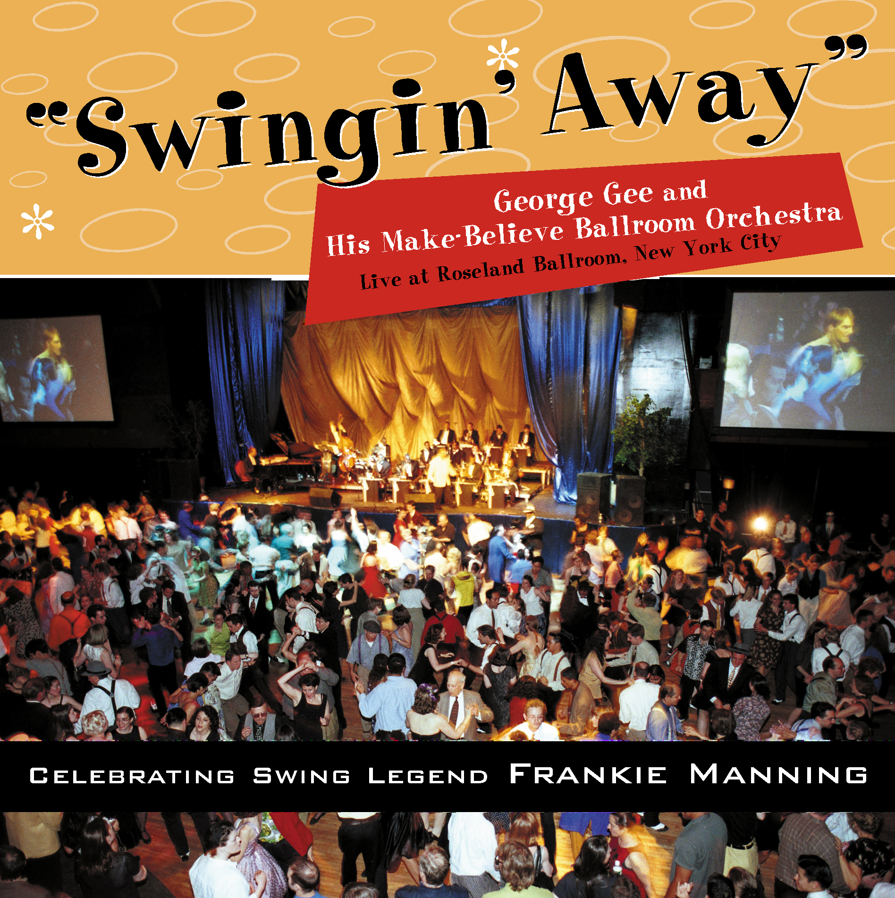
Roseland 1999 1800 Dancers Two Big Bands; George Gee Big Band and Count basie Orchestra
Notes:
Why I am interested in this subject? Since 1996, I have been dancing Lindy Hop, Tango, and Salsa. I met my wife on a dance floor. I have danced all over the US and in 19 foreign countries. I became a Jazz fan because of dancing. I have produced two big Band CD’s. and large dance events such as this one at 1999 Roseland with two big bands and 1800 attendees.

Slide 3
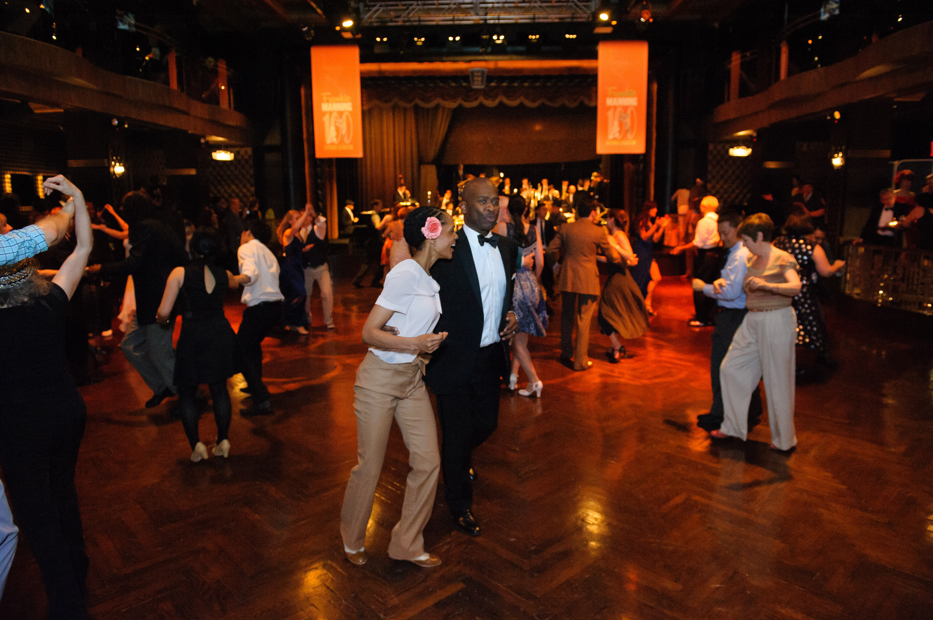
Edison Ballroom 2015
Edison Ballroom 2015 With Jazz at Lincoln Center Youth Orchestra and Dancing Classrooms Lindy Hoppers – for Frankie Manning
Notes:
This event was at Edison Ballroom –with the Jazz at Lincoln Center Youth Orchestra. At the time, this venue did not have a Cabaret License.
Young musicians need venues for them to develop their musical skills.

Slide 4
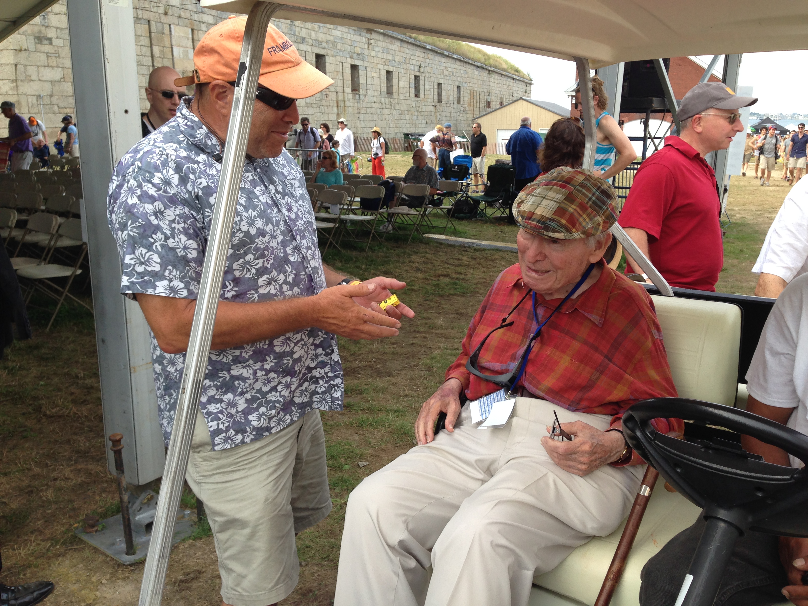
Talking about Dance floors with George Wein - Newport Jazz Festival 2014
Notes:
Music and dance are intricately connected.
Here I am discussin festival dance floors with George Wein at the Newport Jazz Festival.

Slide 5
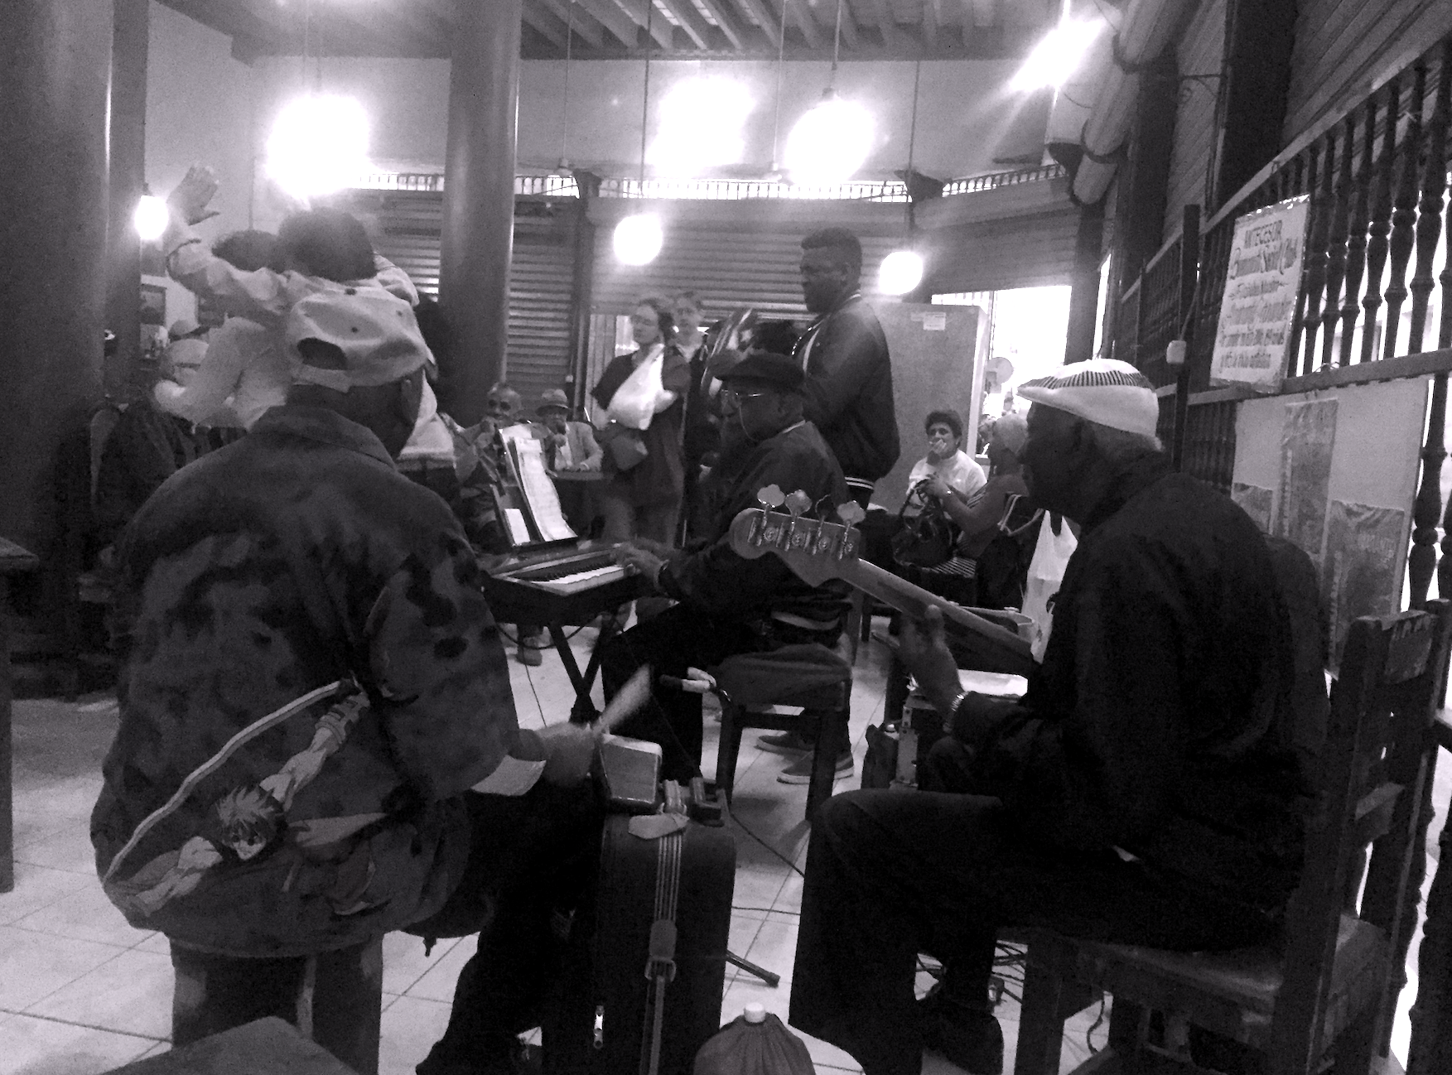
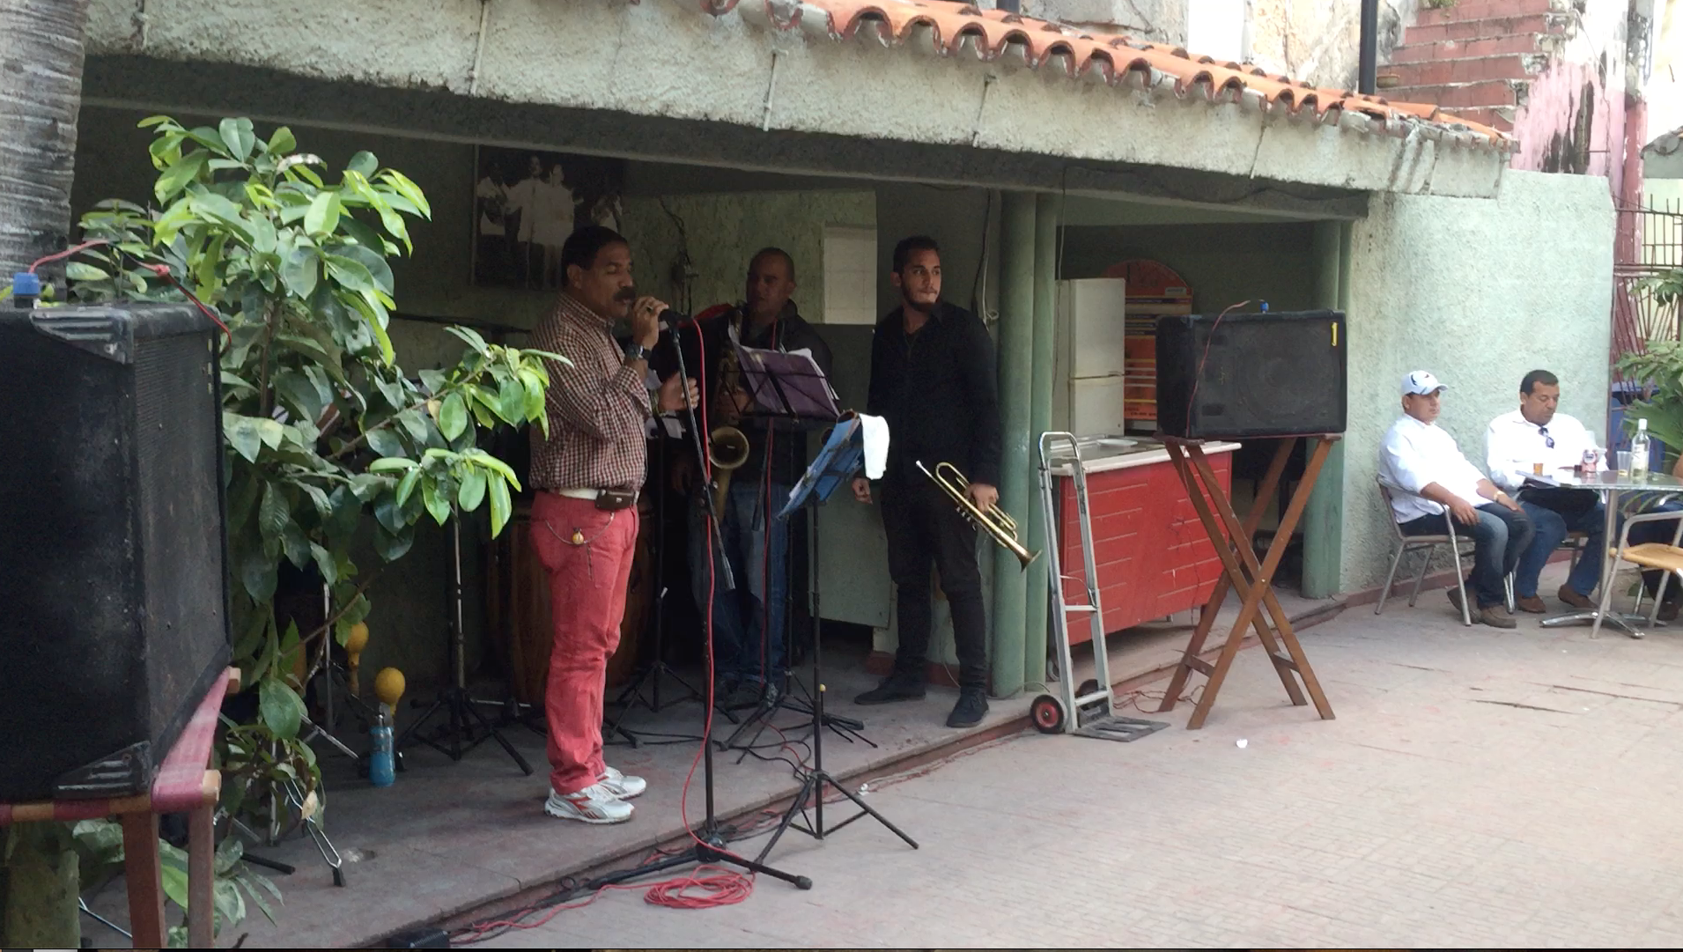
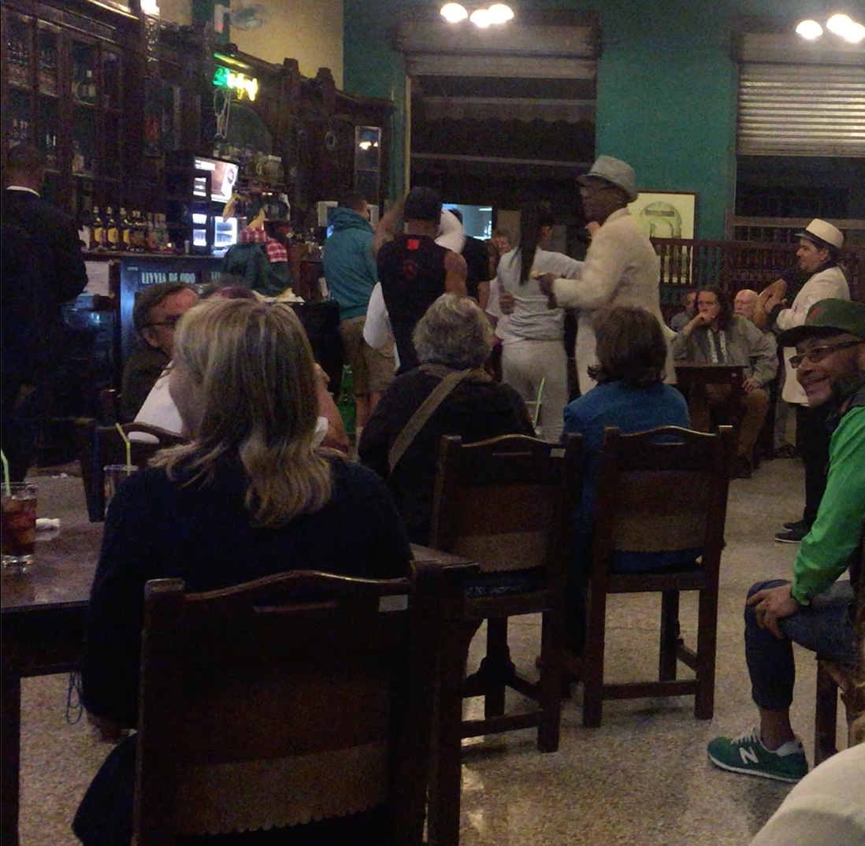
Havana 2016
Notes:
New York is Not Havana!!
Surprisingly, New York City is the most anti-music and anti-dancing place I have been – It is not like Havana, that’s for sure.
When in the fifth grade, my East Tennessee elementary school outlawed dancing – an anti-rock and roll anti-Elvis measure.
Dance regulation in NYC has been my interest since 1997, when a New York Latin restaurant on Houston Street which I patronized was closed by Mayor Giuliani for the “crime” of allowing dancing
That was not the last time that establishments I patronized have had to refuse to allow dancing.

Slide 6
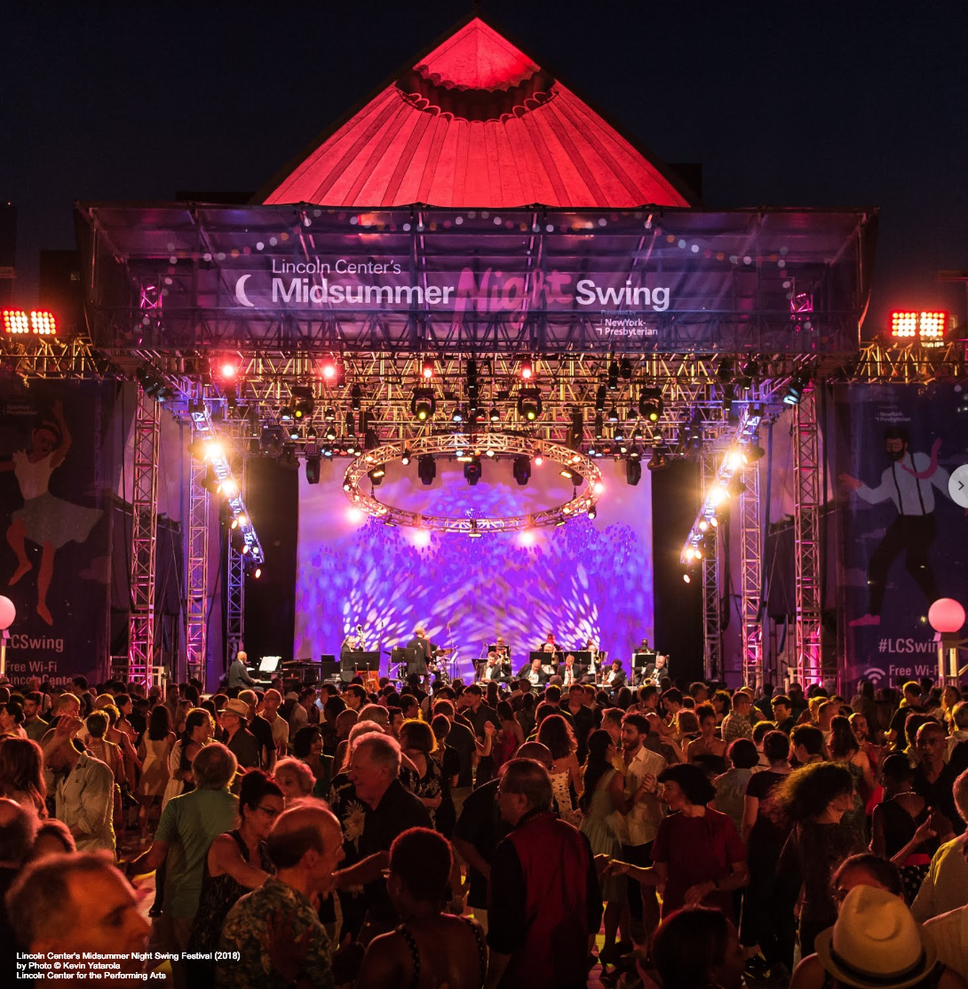
Lincoln Center Midsummer night swing
Notes:
A NYC exception is Lincoln Center’s Midsummer Night Swing – a yearly 15 night event with 40,000 plus social dancer and live bands. Salsa, Lindy Hop, Tango, Hustle, Country Two Step, … Samba.
The event offers work and exposure to musicians bands - all part of the Nightlife economy.
But where do New Yorkers go to dance the rest of the year??
Even with the repeal of the Cabaret Law in 2017, most venues operate with proper legal permission. Even venues in Use Group 12 Districts frequently have not obtained Use Group 12 designations on their Certificates of Occupancy.

Slide 7
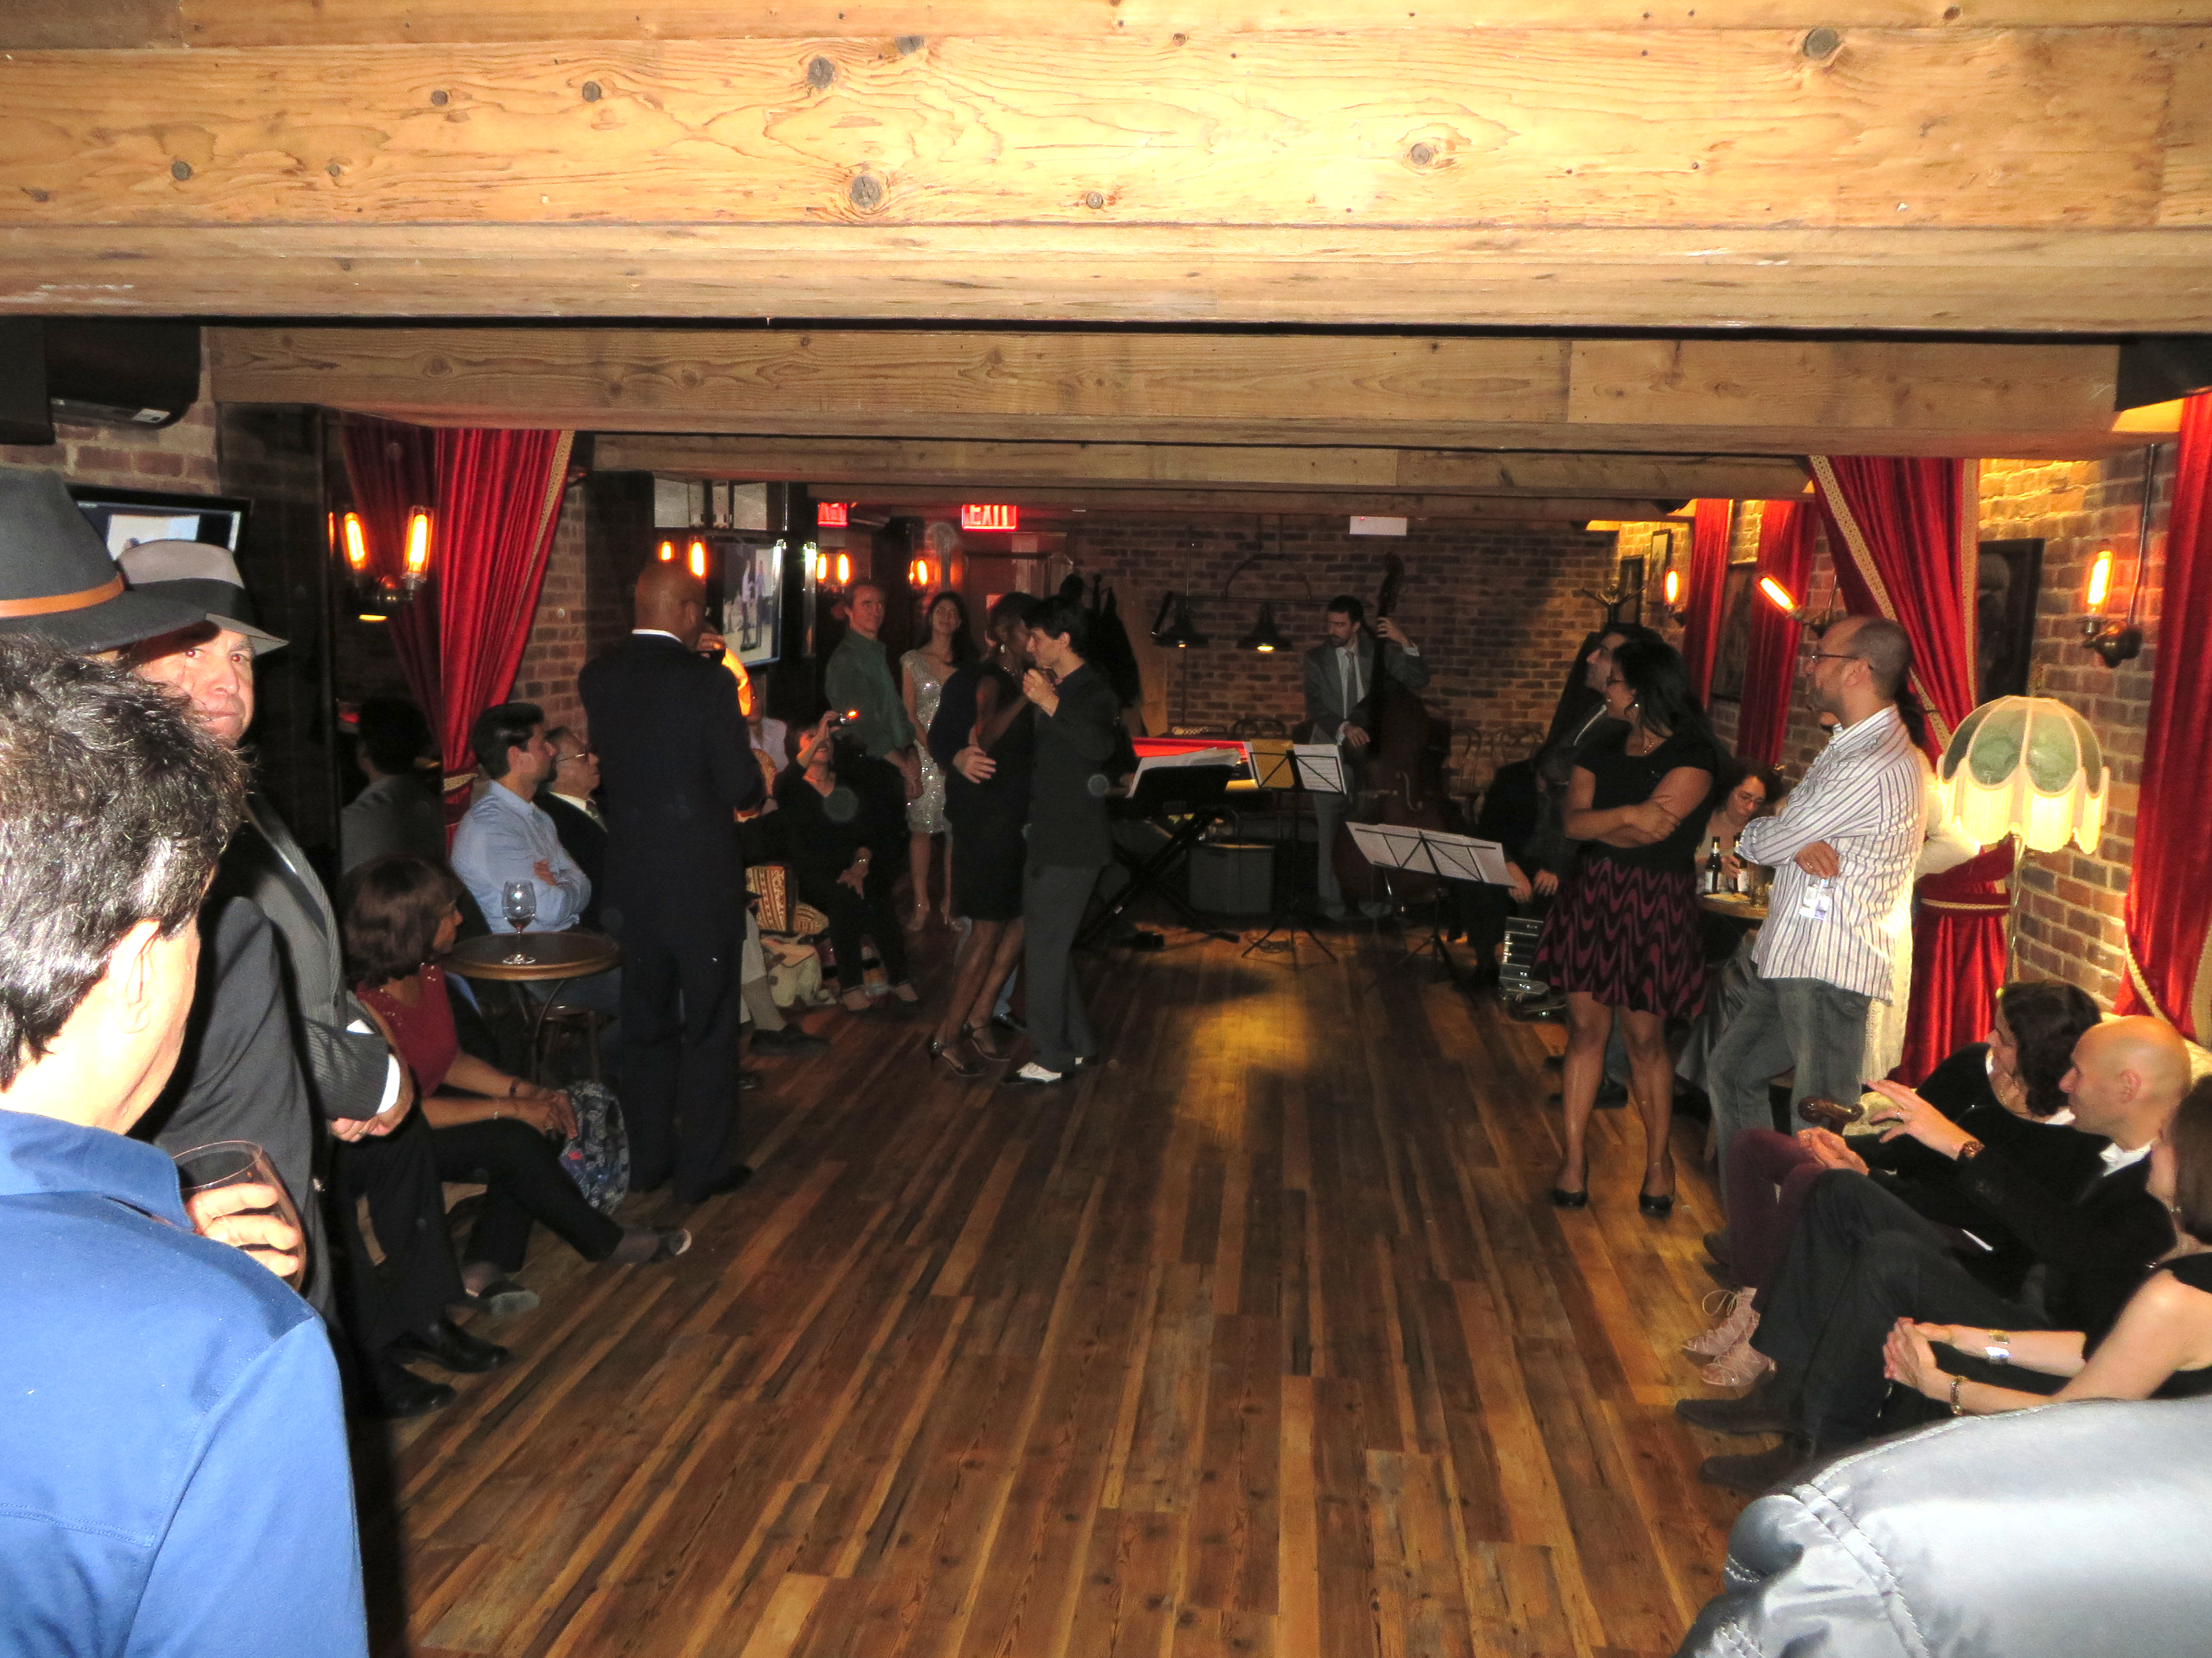
In Violation of Zoning Resolution Use Group 6 Manhattan Restaurant Event Room – With 2019 Grammy winner Giraudo tango Quartet and dancing illegally
Notes:
There are many “illegal” dancing and music events in Use Group 6 restaurants. These venues provide places to dance and support New York City Nightlife and restaurants and musicians - Nightlife is not just about nightclubs.
An example is this event room in a Use Group 6 restaurant. The restaurant probably violated the zoning resolution, its liquor license, its certificate of occupancy, and its public assembly permit by hosting this event - my wife’s birthday party.
Here is her Birthday dance.
I hired Pedro Giraudo’s Tango Quartet. I like to think this and other illegal events helped Pedro win the 2019 Latin Grammy. Musical groups need places to play and perfect their artistry, and live performances allow immediate feedback from listeners.
I can guarantee you that the restaurant earned a profit, the band was paid, and the the local bakery did well. This is what the nightlife economy is all about. It is not just about nightclubs.

Slide 8
Bronx and Queens
Despite the 2 million or more Latinos in New York City, there are few spaces outside of Manhattan allowing Salsa and other Latin dances.
There are three web calendars of New York City Latin events. Almost all events are held in venues from 59th Street South or in Dance Schools, which presumably claim to not be eating or drinking establishments. There is very little in East Harlem, the Bronx or Queens. A recent review of these calendars shows only one restaurant offering a Latin dance night – and to be clear, that is an illegal dancing event, not being in a Use Group 12 venue.
To be clear, any restaurant in those area using back room/event spaces for salsa dancing are violating the Zoning Law and Building Code.
This would apply to, for example, a Quinceañera – the Hispanic tradition of celebrating a girl’s fifteenth birthday – or other celebration, a wedding, an anniversary, or a birthday. ILLEGAL IF IN A USE GROUP 6 RESTAURANT. [as would dancing the Hora at a Jewish Wedding, or Syrtos at a Greek wedding.]
As U.S. District Court Judge Mauskopf stated in the Muchmore decision refusing to dismiss the case: “The City will need to address these arguments and explain why the restrictions imposed by the Cabaret Law, rather than methods which may be less intrusive upon First Amendment rights, are necessary to guard against the harms that the Law was designed to address.”
The City never provided the explanation, instead the City paid Muchmore to drop the case rather than justify the restrictions
Notes:
View

Slide 9
Repeal of cabaret law and establishment of the office of Nightlife and the Nightlife Advisory Board
The Cabaret Law was repealed on November 27, 2017 by Local Law 214. Proposed contemporaneously was a law (Local Law 178) creating the Office of Nightlife and the Nightlife Advisory Board. In part, these were created because all recognized that the repeal did not address other regulatory issues including the Zoning Resolution. One stated purpose of repealing the Cabaret Law was to remove a regulation that disproportionally affected minority communities, but the repeal did nothing to ameliorate the disproportionate affect because of the restrictions of the Zoning Resolution.

Slide 10
…CONTinued
As stated by Council Member Espinal, sponsor of the bills as noted in one article:
“Specifically, the zoning for any establishment that wants to host dancing and music still needs to be addressed, which is not lost on City Councilman Rafael Espinal, who was the key sponsor of legislation to establish an office of nightlife and repeal the Cabaret Law. … Espinal added that he is looking forward to working with the office of nightlife and advocates “to explore our city's archaic zoning code to see how we can build on this progress."
The first task Local Law 178 set for the Advisory Board was to provide recommendations as to “the regulatory structure of the nightlife industry.”
Over two years later, there has been no perceived changes in the regulation of dancing and music under the Zoning Resolution or by the Department of Buildings.

Slide 11
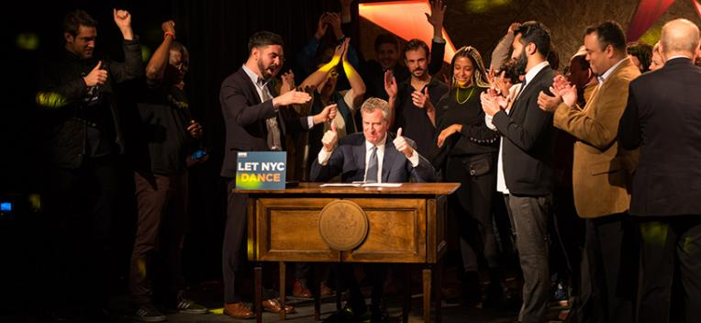
… Officials celebrate while ignoring zoning and code restrictions
Edwin J. Torres/Mayoral Photography Office 11/2017
“the zoning for any establishment that wants to host dancing and music still needs to be addressed”
Notes:
But … nothing modified since November, 2017,

Slide 12
The Zoning Resolution (ZR) – what is it
The Zoning Resolution (ZR) could be described the New York City Zoning Code.
Change to the ZR is under the umbrella of the Department of City Planning and the City Planning Commission.
The ZR is administered by the Department of Buildings.
The Board of Standards and Appeals (BSA) (i.e, the Zoning Appeals Board) handles variances from the requirement of the ZR and Special Permits.
Notes:
What is the Zoning Resolution – ZR. It is the New York City zoning code and enacted by the City Council with multiple agencies involved.

Slide 13
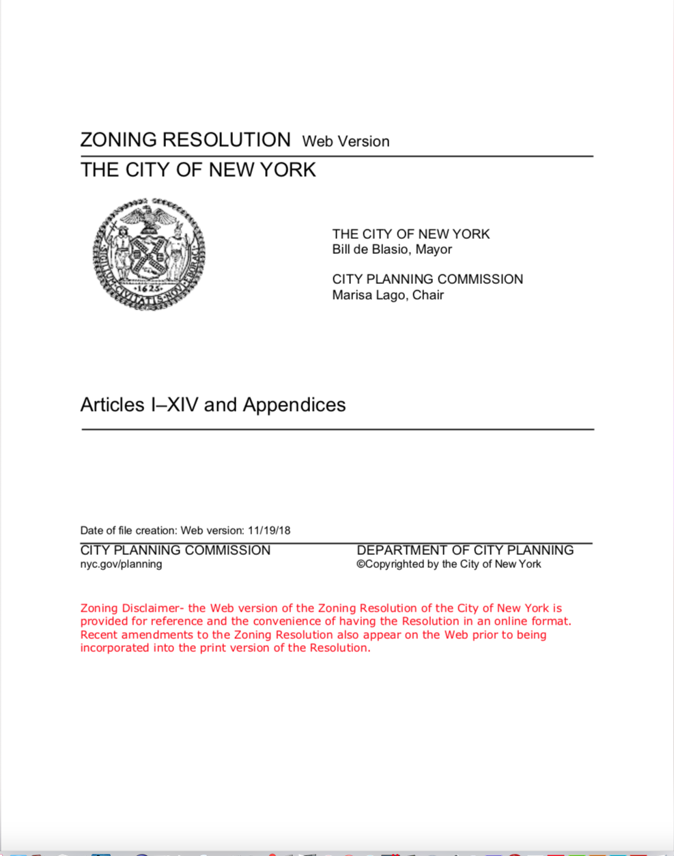
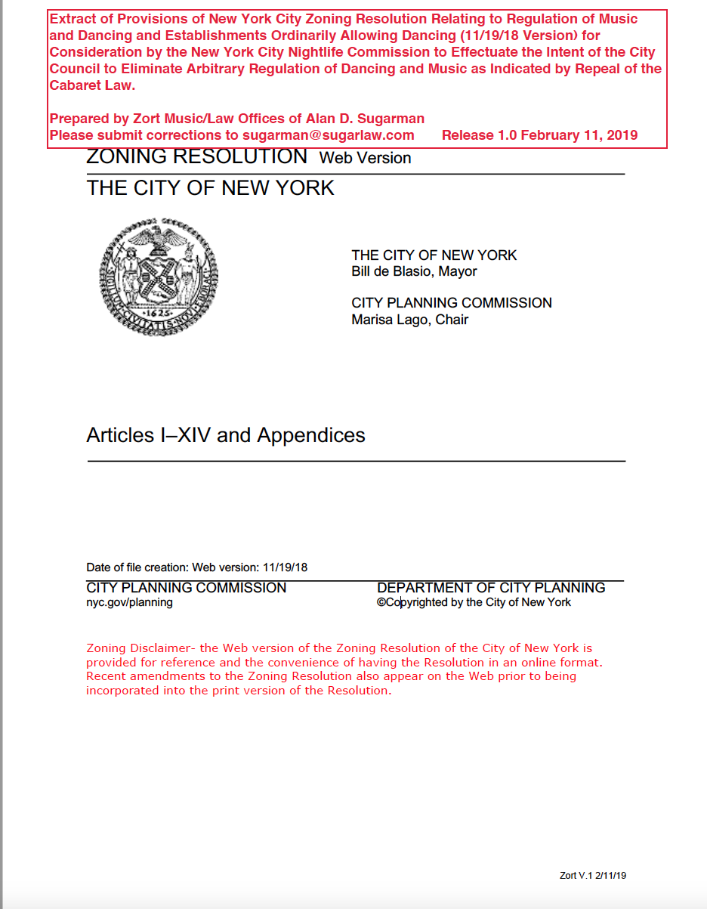
The Zoning resolution: 8683 Pages long! But we have prepared a 155 page extract.
Search Terms Acrobat Advance Search: dancing, dance, music, banquet, catering, showtime, cover charge.
Notes:
The 155 page extract Includes references to clubs, banquet halls, catering halls, and music, all ways which are used to allow the privileged to dance. Thus, it is clear that provisions other than Use Groups 6 and 12 implicate the regulation of dancing and live music.

Slide 14
Fifty-Six ZR References affecting Dancing and Music
ß12-10 Definitions Public banquet halls, ballrooms, or meeting rooms are not permitted #accessory uses#. | ß42-132 Use Groups 6C, 9A, 12B Manufacturing District Regulations | ß82-21 Restrictions on Street Level Uses Special Lincoln Square District | ß95-081 Use Group T Special Transit Land Use District
ß14-124 Music and noise amplification Sidewalk Cafes | ß52-34 Commercial Uses in Residence Districts Non-Conforming Uses | ß85-00 Special United Nations Development District | ß99-00 Special Madison Avenue Preservation District
ß32-15 Use Group 6 | ß62-00 Special Regulations Waterfront Areas | ß85-03 Modifications of Use Regulations United Nations Development District | ß99-03 Special Use Regulations Madison Avenue Preservation District
ß32-18 Use Group 9 Banquet halls | ß62-212 Waterfront-Enhancing (WE) uses | ß87-00 Special Harlem River Waterfront District | ß99-031 Use Group MP Madison Avenue Preservation District
ß32-19 Use Group 10 | ß73-00 Special Permits by the Board of Standards and | ß87-212 Special floor area requirement for certain commercial uses Harlem Riverfront District | ß104-00 Special Manhattanville Mixed Use District
ß32-21 Use Group 12 | ß73-241 Eating or Drinking BSA Special Permits C1-_ M15_ | ß88-00 Special Hudson Square District | ß104-16 Use Group MMU Manhattanville Mixed Use District
ß32-22 Use Group 13 Banquet Halls | ß73-242 In C3 District Easting or Drinking BSA Special Permit | ß88-13 Commercial Use Special Hudson Square District | ß104-131 Use Group 6A Special Manhattanville Mixed Use District
ß32-23 Use Group 14 Clubs | ß73-243 C1-1, C1-2 and C1-3 Districts BSA Special Permits | ß91-00 Special Lower Manhattan District | ß109-00 Special Little Italy District
ß32-30 USES PERMITTED BY SPECIAL PERMIT | ß73-244 In C2, C3, C4, C6-4, M1-5A, M1-5B, M1-5M and M1-6M Districts, the Special Hudson Square District and the Special Tribeca Mixed Use District | ß91-061 Applicability of special permits by the Board of Standards and Appeals Lower Manhattan District | ß109-211 Use Group LI Special Little Italy District
ß32-31 Special Permits By the Board of Standards and Appeals | ß81-00 Special Midtown District | ß91-112 Eating and drinking establishments with dancing in C5 Lower Manhattan District | ß112-00 Special City Island District
ß42-00 Manufacturing District Regulations | ß81-82 Special Regulations on Permitted and Required Uses Fifth Avenue Subdistrict | ß94-00 Special Sheepshead Bay District | ß112-073 Uses permitted in C3 Districts Special City Island District
ß42-13 Use Groups 6C 12B Manufacturing District Regulations | ß81-722 Use Group T Special Midtown District | ß94-062 Use Group SB Sheepshead Bay District | ß118-00 Special Union Square District
ß42-14 Use Group 17 -M1 M2 M3 Manufacturing District Regulations | ß81-725 Entertainment-related uses Special Midtown District see 81-724 | ß94-063 Uses permitted by City Planning special permit -Sheepshead Bay | ß118-11 Ground Floor Uses Special Union Square District
ß42-31 Special Permits Board of Standards and Appeals Manufacturing District | ß82-00 Special Lincoln Square District | ß95-00 Special Transit Land Use District | Appendix A_ Index of Uses
Notes:
There are Fifty-Six Sections of the Zoning Resolution affecting dancing and music; these are included in the 155 page extract we prepared. Despite the many provisions, not one provision defines dancing. The Zoning Resolution is subject to the challenge of being declares unconstitutional on the grounds of vagueness and a violation of the First Amendment. The US District Court for the Eastern District of New York (Brooklyn).

Slide 15
The zoning Resolution failure to define “dancing” suggest that it is vulnerable to Constitutional challenge
FROM MUCHMORE DECISION: ”Because the term “dancing” is not limited in the Cabaret Law, it arguably regulates a wide range of activities: not only purely performative dancing and Stanglin-type “recreational dancing,” but also many forms of participatory dancing that arguably fall somewhere in between, for example, folk dancing and other forms of ethnic or cultural dancing that arguably implicate protected expression. See Elam, 53 F. Supp. 2d at 859 (“Some other forms of dance (29) are likewise deserving of First Amendment protection because of the degree of their communicative element.”); Salem Inn, Inc. v. Frank, 381 F. Supp. 859, 863 (E.D.N.Y. 1974) (finding that “all dancing is not per se a mode of expression protected by the First Amendment [, but] [f]ew could reasonably deny that ballet and certain ethnic folk dances communicate stories and ideas”). Dancing plays an important role in our society and in many others around the world. Dancing expresses joy and binds communities. It can be an intimate moment between a couple. Elam, 53 F. Supp. 2d at 859 n.7 (“dancing between adults often has a definite communicative element, such as expression directed to attract a mate in a bar or a discotheque”). It can capture a moment of celebration for a group bound together by a common interest, culture, or feeling. Dancers taking part in recreational folk dancing reflecting their culture convey a particularized message of cultural pride; a message that the environment and circumstances of the dancing can help make clear. See, e.g., Folk Dance Fridays at the Hungarian House, http://www.uppereast.com/folk-dancing (last visited Sept. 6, 2016) (“The nature of folk dancing is inherent in building and developing community.”).”
Notes:
Despite these many provisions, not one provision defines dancing. The Zoning Resolution is subject to the challenge of being declared unconstitutional on the grounds of vagueness and a violation of the First Amendment. The US District Court for the Eastern District of New York (Brooklyn) found that the provisions in the Cabaret Law similar to those in the Zoning Resolution made that law subject to constitutional challenge.

Slide 16
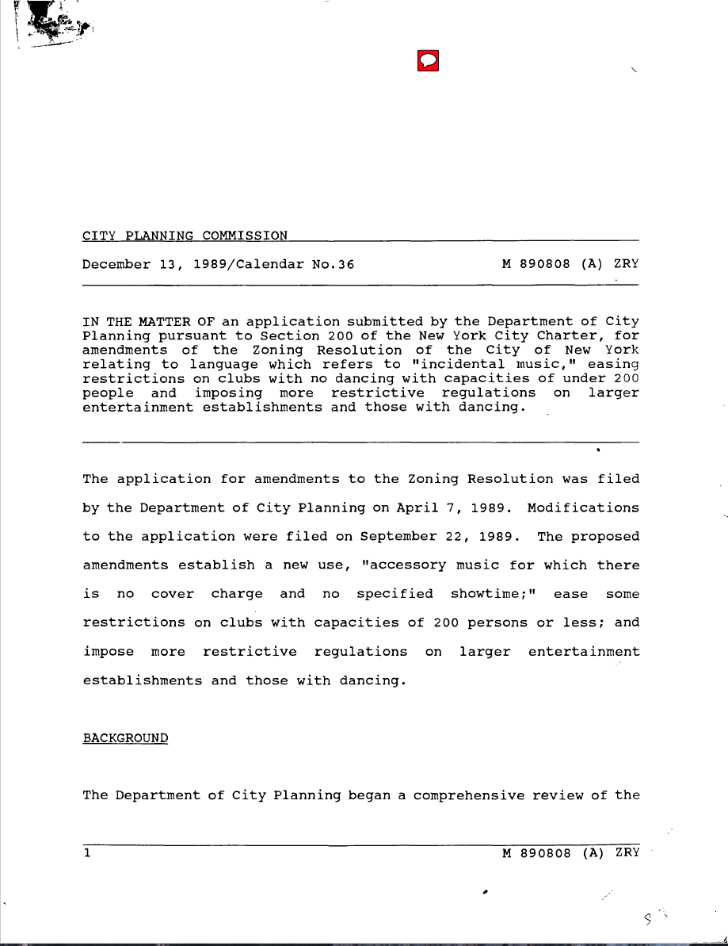
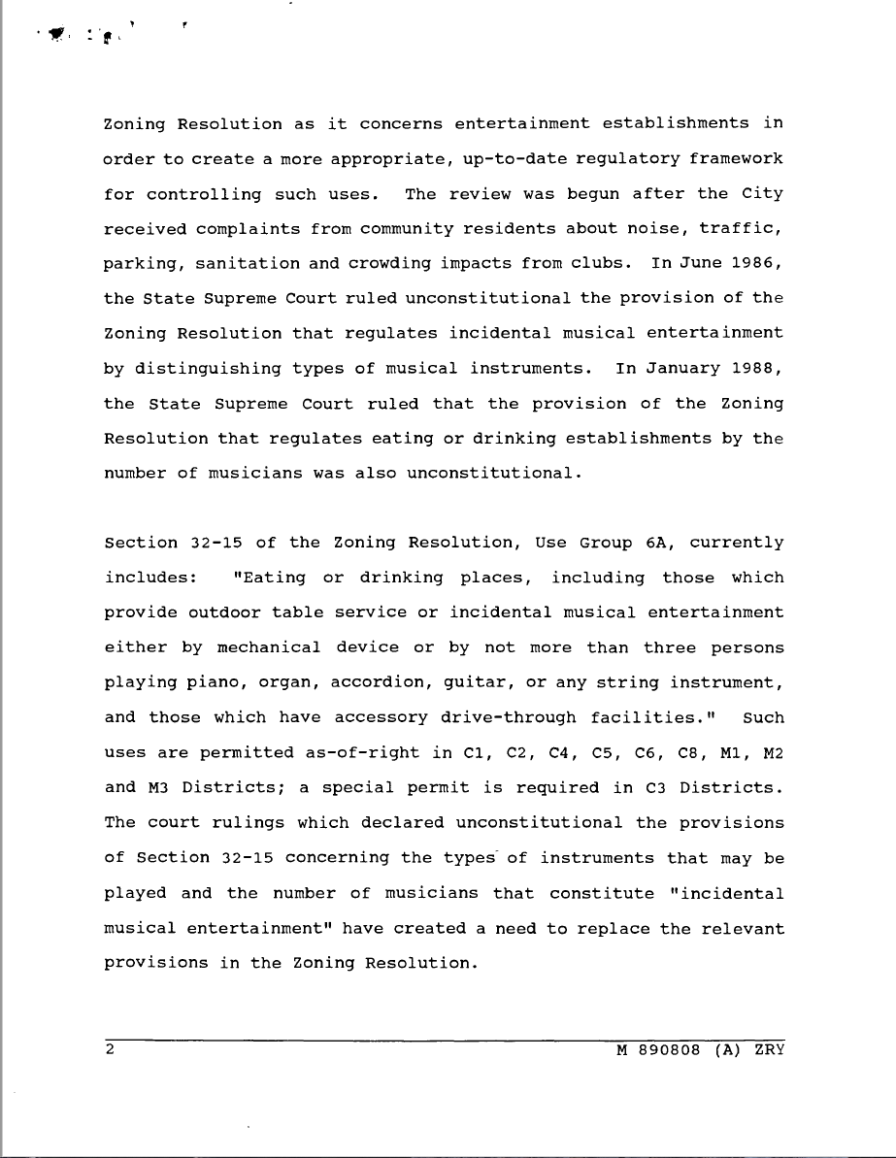
1989 dcp Comprehensive Review
Report at CPC Website. Report at Zortmusic.con. http://zortmusic.com/CabaretLaw/ZR/
Notes:
In 1989, after the City lost litigation declaring limits on music and number of musicians as unconstitutional, the DCP undertook a comprehensive review of regulations affecting music and dancing with the express intent to crack down on dancing.
For an excellent discussion of the 1989 review and other issues, see Wei, Whitney (2016), Clubbed to Death: The Decline of New York City Nightlife Culture Since the Late 1980s, Columbia University Bachelor’s Thesis.

Slide 17
The 1989-90 Amendments were intended to impose restrictive regulations upon dancing
In 1989, DCP conducted “a comprehensive review of the Zoning Resolution as it concerns entertainment establishments in order to create a more appropriate, up-to-date regulatory framework for controlling such uses.” DCP then issued a report with proposed amendments stating among other things that the amendments were intended to:
“impose more restrictive regulations on larger entertainment establishments and those with dancing.”
The result were a series of measures which were intended to replace and make harsher the restrictions which had been declared unconstitutional. The new language added requirements for waiting areas, prohibition of dancing, and restrictions affecting the livelihood or musicians, and used undefined terms such as “dancing” and “musical entertainment”, “showtime”, and “cover charge.”
Notes:
The purpose of the 1989 review is clear – QUOTE - “to impose more restrictive regulations on larger entertainment establishments and those with dancing.” The review did not discuss what is meant by “dancing”. Appears to assume that ”dancing” means large dancing nightclubs.

Slide 18
The 1989 Amendments created many of the today’s restrictions – underscored Text added in 1989
Notes:
The 1989 report deleted statutory text that placed no limits on entertainment or dancing with new language which restricts dancing. Nothing in the history of the addition of language imposing significant restriction on dancing indicates that any thought was given to its impact.

Slide 19
§ 32-15 Use Group 6 Text
C1 C2 C4 C5 C6 C8
“Eating or drinking establishments, including those which provide outdoor table service or have music for which there is no cover charge and no specified showtime, and those which have #accessory# drive-through facilities [PRC-B]”
“Eating or drinking establishments with entertainment, but not dancing, with a capacity of 200 persons or fewer4 [PRCB] Eating or drinking establishments with musical entertainment but not dancing, with a capacity of 200 persons or fewer [PRC-B]”
“Eating or drinking establishments with musical entertainment but not dancing, with a capacity of 200 persons or fewer [PRC-B]’

Slide 20
§ 32-21 Use Group 12
Use Group 12 applies to the following districts: C4 C6 C7 C8 - as well as to certain “M” districts.*
“**Eating or drinking establishments with entertainment and a
capacity of more than 200 persons, or establishments of any
capacity with dancing [PRC-D]”
Additional requirements re waiting areas in many districts – 4 square feet per person. Also, limitations of 100 feet or more from residential districts.
Note: Only C7 and C8 districts are also in Use Group 6. C4 and C6 districts seem to not be able to have ANY eating and drinking establishments unless over 200 persons.
UG 12 allows certain exemptions to be allowed by Special Permit by the Board of Standards and Appeals, but this relief valve is limited, expensive, and rarely used. See the Red Rooster Case Study Below.
Notes:
.
Few venues have sought and obtained special permits allowing dancing, and this escape valve is meaningless in the real world.

Slide 21
other Use Dancing proviSions in zr
Other somewhat complex provisions in § 42-00 et seq. of the Zoning Resolution allow or restrict dancing in M1, M2, and M3 districts, some with special permits. § 73-244. § 42-32.
Hotels may allow dancing in Use Group 12 – C4, C5, C6 and C8. § 32-19. Use Group 10.
Banquet Hall are allowed in certain districts, but there is nothing stated allowing dancing in Banquet Halls. Use Group 9. §32-18.
Many Special Districts have provisions allowing or restricting dancing, some allowing waivers by the City Planning Commission. § 27-212. Harlem Riverfront District. See § 91-112 for Special Provisions for C5 Districts in the Special Lower Manhattan District, limiting dance floors sizes to 400 square feet.
In sum, it is a over-simplifications to state that Use Group 6 and 12 fully describe restrictions against dancing and music in the Zoning Resolution.
Notes:
*Few venues have sought and obtained special permits allowing dancing, and this escape valve is meaningless in the real world.

Slide 22
Where Dancing IS Not Allowed
The inverse to this question is where is dancing not allowed – and basically that would mean residential districts and Use Group 6 Districts. Dancing may or not be allowed in the other districts. We asked the Department of City Planning if it would prepare a map showing where dancing is not allowed, but they would not do so. We used ZoLa to attempt to show areas where dancing is Not allowed – essentially UG 6 Districts and Residential Districts. See: https://tinyurl.com/NoDancing-NYC.

Slide 23
Where is Dancing Not Allowed – In Yellow
https://tinyurl.com/DancingMapNYC.)

Slide 24
Harlem 1932 – No dancing 2019
Notes:
Harlem in 1932 just prior to end of Prohibition with 500 Speakeasies and clubs serving all parts of society. Zoned “no dancing” now.

Slide 25
city planning Commission Should Conduct a New Comprehensive review
Respectfully, the Advisory Board and Nightlife Office should request, and the Mayor should require, the DCP to undertake another comprehensive review, as performed in 1989, providing a zero-based justification of every single restriction and condition as related to musical entertainment, entertainment and dancing. As part of the analysis, proper accurate mapping should be provided.
Notes:
In our view, it is fundamental that the 1989 report be considered prior to moving forward with consideration of needed changes in the las.
The new review needs to be “zero-based” where every assumption and current statement requires a justification.

Slide 26
Regulations of other agencies will be discussed later
To provide context, specific proposal will be made.

Slide 27
Introduction
I will suggest a few proposals to amend the 8683 page Zoning Resolution, although reluctant to do so for the suggestions are not all inclusive due to time constraints and there are rules of other agencies.
I will provide some context and a little history.
An underlying problem: absence of definition such as “dancing,” ”cover charge,” “musical entertainment.”
I will not cover significance of other use categories such as banquet and catering halls and clubs which exist partly to allow dancing for certain classes.
Notes:
Informed proposals for change suggest knowledge of the 8683 page Zoning Resolution and the history of regulations. Sorry – it is dense, poorly organized, at times vague, and inconsistent.
I will introduce some specific proposals concerning the Zoning Resolution which impact dancing and music and also will provide some context and some history.
Many people focus only on Use Group 6 and 12 provisions, but there are many many other provisions curtailing dancing and live music. One notable provision – there is no definition of dancing.
In addition, there are rules of other agencies’ impact dancing

Slide 28
Proposal 1 UG 6 Allow Dancing - under 100 Dancers
Use Group 6 should allow dancing up to at least 100 persons, without a venue having to be in a Use Group 12 district.
Notes:
My first proposal is to amend Use Group 6 C in the Zoning Resolution to remove the restrictions on dancing in most restaurants in the City.
The Zoning Resolution establishes Use Groups to which zoning districts are assigned. Many zoning districts are assigned to multiple use groups
Note § 91-112 which allows dancing if the dance floor is under 400 square feet.

Slide 29
Proposal 1 UG 6 remove “but not dancing”, “entertainment” and “musical Entertainment” In ZR §32-15 C.
§32-15 C Eating or drinking establishments with entertainment, but not dancing, with a capacity of 200 persons or fewer.
§32-15 C Eating or drinking establishments with musical entertainment but not dancing, with a capacity of 200 persons or fewer.
Note: After removing “with entertainment, but not dancing,” the second clause becomes redundant and should be deleted.
Reference to “musical entertainment” is constitutionally suspect after the Chiasson decisions and ZR provides no definition for either term.
Notes:
There is an unusual distinction affecting live music and really makes no sense. §32-15 C. One clause is redundant.
The words with entertainment, but not dancing need to be removed and replaced with “entertainment with or without dancing with a dancing capacity of 100 persons or less and an overall capacity of 200 persons or fewer.”

Slide 30
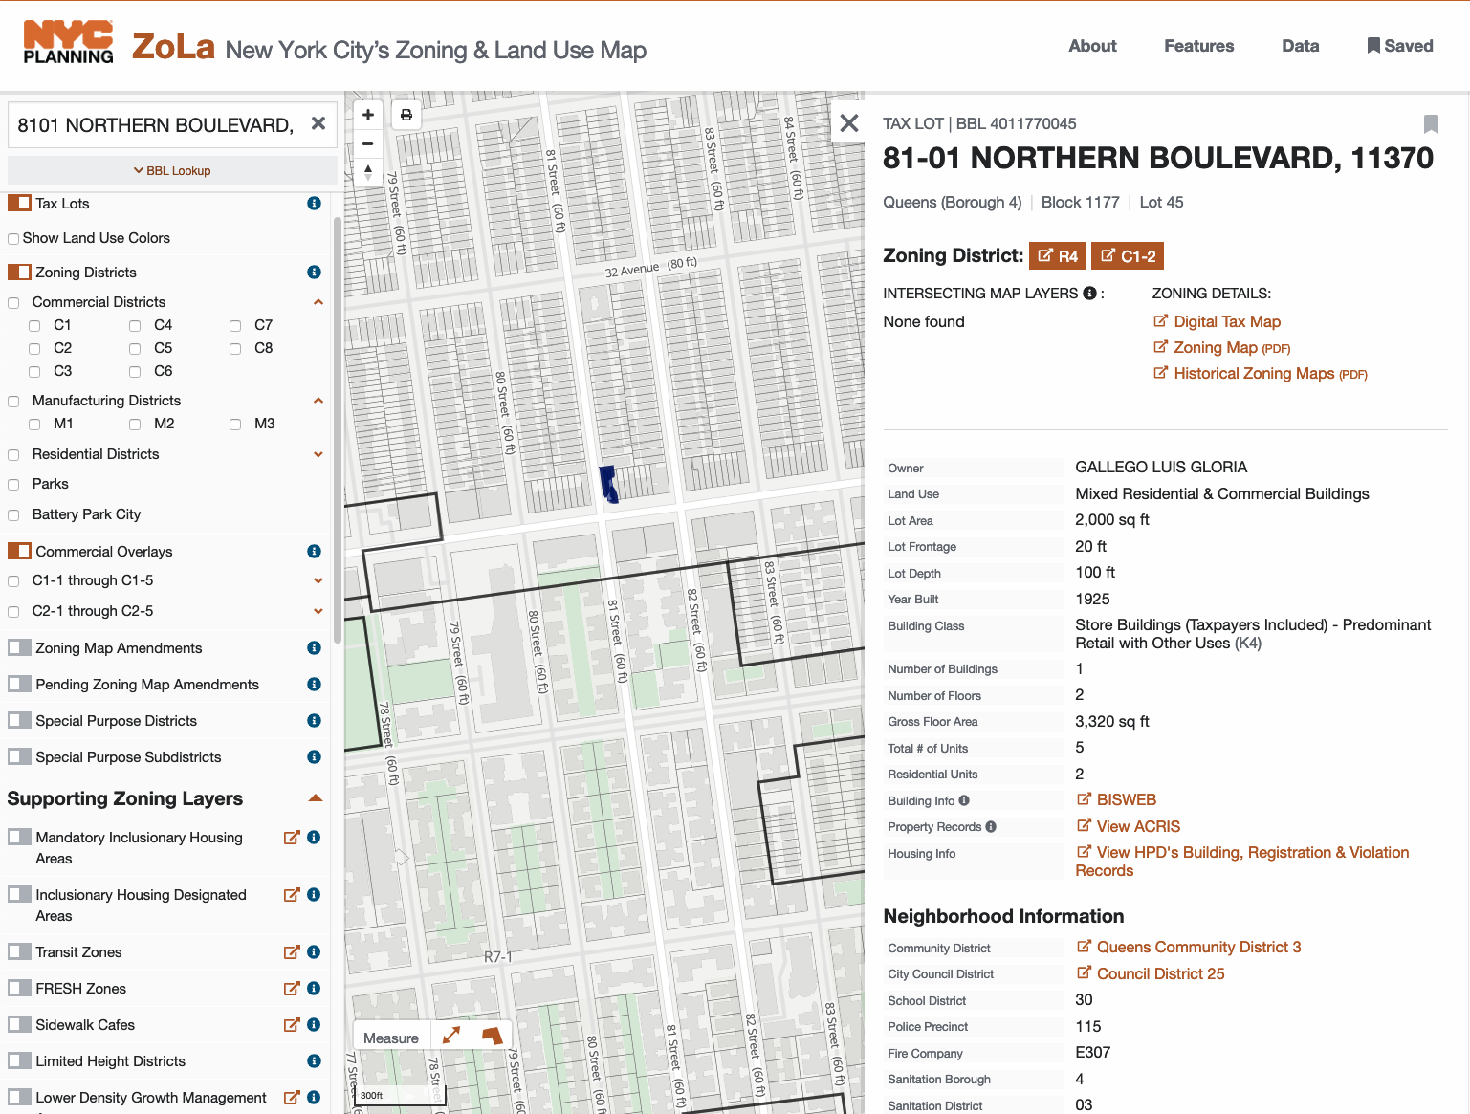
Proposal 1 Example of A UG 6 restaurant - no dancing ever
Notes:
Here is a ZoLa map of a UG 6 restaurant you may know in Queens in a C1-2 district. Dancing is not allowed – period. No Salsa. No Bachata. No Punta.

Slide 31
Proposal 1-A dob must immediately withdraw the “Cabaret” brochure
This Pamphlet should have been withdrawn in December, 2017. It is discussed later in detail. It is embarrassing that the document is still featured on the DOB Web Site. Similarly, underlying DOB definitions of dancing and cabaret, which merely channeled the Cabaret Law, should be immediately withdrawn.

Slide 32
Proposal 2 UG 6 - remove ZR §32-15 A as redundant
§32-15 A
“Eating or drinking establishments, including those which provide outdoor table service or have music for which there is no cover charge and no specified showtime, and those which have accessory drive-through facilities.”
§32-15 A has no meaning if §32-15 C is amended by deleting “with entertainment, but not dancing.” The cover charge and show time restriction is confusing and is discussed later
Note: Current §32-15 A does not prohibit dancing as written!!!
Note: Current §32-15 A language re drive-through conflicts with §32-31.
Notes:
The next proposal concerns another Use Group 6 use. Remove §32-15 A as redundant, confusing, conflicting with 32-15 C, and as next discussed, constitutionally suspect.
It is hard to understand the distinction between “or have music” and “musical entertainment” in C.
§32-15 A is not meaningful except as to the restriction re cover charges and showtimes, terms not defined. §32-15 C allows restaurants with entertainment without showtimes and cover charges. So, A makes no sense. Recommend eliminating all of §32-15 A as if C is amended.

Slide 33
… Proposal 2 - §32-15 C
§32-15 A
“Eating or drinking establishments, including those which provide outdoor table service or have music for which there is no cover charge and no specified showtime, and those which have accessory drive-through facilities.”
§32-15 A has no meaning if §32-15 C is amended by deleting “with entertainment, but not dancing.” The cover charge and show time restriction is confusing and is discussed later.
§32-15 C provides:
Eating or drinking establishments with entertainment, but
not dancing, with a capacity of 200 persons or fewer4 [PRCB]
Eating or drinking establishments with musical entertainment
but not dancing, with a capacity of 200 persons or fewer. [PRC-B]
Notes:
The next proposal concerns another Use Group 6 use. Remove §32-15 A as redundant, confusing, conflicting with 32-15 C, and as next discussed, constitutionally suspect.
It is hard to understand the distinction between “or have music” and “musical entertainment” in C.
§32-15 A is not meaningful except as to the restriction re cover charges and showtimes, terms not defined. §32-15 C allows restaurants with entertainment without showtimes and cover charges. So, A makes no sense. Recommend eliminating all of §32-15 A as if C is amended.

Slide 34
… Proposal 2 Use Group 6 Under 200 Persons – dancing to be allowed
The ZR should be amended so that a restaurant qualifying under §32-15 A should be allowed to permit dancing, if occupancy is under 200 persons.
Amend relevant sections in both UG 6 and UG 12.
Notes:
Confusion exists as to meaning of uses allowed in Use Group 6 and 12, and some may note that a venue is located in Use Group 12 but may not be aware that the venue is also located in Use Group 6.
The definition in ZR is that listed uses are allowed in the Use Group.
But venues may be located in districts under both Use Groups.
Any Use listed under UG 6 is allowed in districts under UG 6, even if not listed under UG 12.
Strictly speaking dancing is allowed under UG 6 A though it appears that my interpretation is not followed.
Many Use Groups involve dancing – not just UG 6 and UG 12. UG 10 applies only to hotels.

Slide 35
Regulatory review and auDIT
.
Notes:
Executive Order 13563 of January 18, 2011

Slide 36
Regulatory review and auDIT
Review and Audit of Statutes, Code, Rules, Regulations, Advisories, Policy Memoranda, Rule Interpretations beyond the Zoning Resolution.
Evaluate existing regulations and “make recommendations to the agency head regarding their repeal, replacement, or modification”
Identify outdated and inconsistent Regulatory Documents
Identify outmoded, ineffective, insufficient, or excessively burdensome, regulations and modify, streamline, expand, or repeal them in accordance with what has been learned.

Slide 37
Regulatory review and auDIT
A part of a regulatory review is to review on-line information systems providing information to the public.
In some instances, on-line information is out of date, not well identified, or incomplete.
Example: locating Public Assembly Permits on-line on the DOB site.
Reviewers should access the sites and attempt to find information for property and venues known to the reviewer - a true random audit test.

Slide 38
Regulatory review and auDIT
. .. integrated cost-benefit analysis into DEEP by doing an across-the-board review of the agency’s regulations, which led the department to lower regulatory compliance costs. Moreover, he worked with his agency management team to identify and repeal outdated, duplicative, and other unneeded regulations, which further streamlined the process for private actors
Notes:
https://www.theregreview.org/2018/01/09/private-sector-principles-achieve-excellence/
Using Private-Sector Principles to Achieve Regulatory Excellence
Regulatory Excellence: Lessons from Theory and Practice 133 Chapter in
https://www.brookings.edu/wp-content/uploads/2016/05/table-of-contents_-achieving-regulatory-excellence-9780815728429.pdf
Achieving Regulatory Excellence
https://www.brookings.edu/book/achieving-regulatory-excellence/

Slide 39
Proposal 3 UG-6 eliminate requirements based upon “cover charge” and “showtimes” - hurts musicians
§32-15 A
“Eating or drinking establishments, including those which provide outdoor table service or have music for which there is no cover charge and no specified showtime, and those which have accessory drive-through facilities.”
”Cover Charge” means establishment cannot cover costs of band, and musicians are not paid properly.
“Showtimes” Imprecise. Makes no sense if the venue is not emptied after each set. Can be arbitrarily applied to set times. Totally different.
DCP should be asked to provide a reasoned rationale for maintaining these and all other restrictions in the Zoning Resolution. The reference to “cover charges” and “showtimes” appears in nine other sections of the Zoning Resolution.
Delete all of the same references in the 10 other regulations in the Zoning Resolution such as §81-82.
Notes:
[Also for §32-15 A. Delete references to music Cover Charge and Showtimes. -- not defined, impact negatively on musicians and establishments, and are constitutionally suspect.]
Delete these restrictions in all ten places in the Zoning Resolution such as §81-82.

Slide 40
Proposal 3 Cover charges and Showtime: §32-15 A Versus §32-31Inconsistency
§32-15 A: “Eating or drinking establishments, including those which provide outdoor table service or have music for which there is no cover charge and no specified showtime, and those which have #accessory# drive-through facilities.²”
§32-31 Eating or drinking establishments, including those which provide outdoor table service or have music for which there is no cover charge and no specified showtime, which have #accessory# drive-through facilities.
§32-31 Eating or drinking establishments, including those which provide musical entertainment but not dancing, with a capacity of 200 persons or less, or outdoor table service, which have #accessory# drive-through facilities [PRC-B]
Notes:
The language difference between 32-31 and 32-15 suggest mistakes in drafting, which have not been corrected in 30 years.

Slide 41
Proposal 4 Proposal Other ZR and DOB provisions limiting the playing of live music
§14-124 Prohibiting live music in enclosed sidewalk cafes decreases opportunities for musicians – many sidewalk café open into the restaurant.
Allowing any music to be defined as a Cabaret invokes requirements of sprinklers, even in small spaces.
Prohibiting dancing means owners do not wish to book bands that people like for dancing – owners must play fun spoiler.
Notes:
[ Need to review other provisions of ZR, DOB, and SLA re restrictions on music and impact on dancing.]

Slide 42
Proposal 5-1 definitions define “establishment” clearly for venues with multiple Floor re 200 Person Occupancy
Clarify definition of terms “Establishment” and “200 person capacity.”
If establishment has multiple floors or venues under same operation, ZR is not clear as to whether 200 person limits applies to all floors together or each floor separately.
May or may not include establishment staff and performers.
Some establishments have different operations on multiple floors – i.e Jazz Standard/Blue Smoke, Red Rooster/Ginny’s, Birdland/Birdland Theater.
Allows too much discretion to inspectors and interpretations may change.
Instructions for Public Assembly Certificate allows separate permit for each floor.
Notes:
[Definitions: 200 person capacity standard needs definition where establishments have multiple venues. If capacity of both venues exceeds 200, waiting rooms and other conditions are imposed.
Allows regulators and inspectors to exercise dangerous discretion and does not alert owners as to the applicable rules.

Slide 43
Proposal 5-2 Definitions define Dancing to be 50 or fewer persons dancing simultaneously
If not politically feasible to delete all restrictions on dancing, then provide a definition of “dancing” to apply to all City codes and regulations and rules including fire code and building code: i.e, 50 persons or more dancing (not patrons in establishment.)
Notes:
[The next definition needed is one for “dancing”. Ideally, all references to dancing should be removed in the codes and regulations. This is offered for discussion purpose only as an alternative to apply not only to the ZR, but to all City codes and rules and regulations. ]

Slide 44
Proposal 5-3 Definitions C5 Lower Manhattan District dance floor under 400 square feet
§91-112:
In all C5 Districts within the #Special Lower Manhattan District#, in addition to eating and drinking establishments permitted pursuant to Section 32-15 (Use Group 6), the following types of eating and drinking establishments shall be permitted: eating or drinking establishments with entertainment, including musical entertainment or dancing, with a total capacity of 200 persons or fewer, provided that the dance floor or area, if any, does not exceed 400 square feet [plus waiting area requirements].
This is an example of creative crafting of zoning language.
Notes:
[ Another possible definition is to define dance venues by the dance floor size: §91-112 offers a type of compromise as opposed to removal of all dancing restrictions.]
For example, dancing allowed if dance floor less than 900 square feet. Could combine with restriction based upon number of dancers.

Slide 45
Proposal 6 Use Group 12 – delete reference to “establishment of any capacity with dancing”
Delete the words “establishments of any capacity with dancing” from §32-21 which defines Use Group 12: “Eating or drinking establishments with entertainment and a capacity of more than 200 persons, or establishments of any capacity with dancing.“
This requirement is particularly silly for it treats an establishment with a capacity of more than 200 in exactly the same way as an establishment with a small dance floor for 20 dancers or so.
This language appears in other ZR provisions such as §85-03.
Statutory interpretation issues – allowed uses are not exclusive!
Notes:
[Removal of the language implied in UG 12 equating any number of dancers with an establishment 200 capacity. Imposes waiting rooms on venues with small dance floors and only a few dancers or in manufacturing zones.]
Since most UG 12 districts are also in UG 6, this provision would be irrelevant if an amended UG 6 allowed dancing if capacity under 200.

Slide 46
Proposal 7 Limit jurisdiction of Bsa and reduce application fees
Many regulations require establishments in certain districts to apply for a Special Permit if dancing is to be allowed. Due to BSA acting as a super regulator to assure compliance with fire and safety issues and other costs, the process is very expensive. See Red Rooster case study.
The Special Permit requirement is there to protect neighbors from noise and congestion – the ZR should be amended to severely limit BSA scope of review. BSA should be limited to review of only those issues that directly impact congestion, leaving it to the Fire Department and DOB to address issues of egress and fire safety without oversight by BSA. Noise Regulation should be regulated by DEP. There should be no CEQR requirement.
Notes:
[Thousands of words are devoted to obtaining a Special Permit from the BSA to allow dancing in certain districts.
Not simple and allows BSA to micro-regulate all aspects of the establishment Only three establishments in NYC have current Special Permits to allow dancing.]
Not be BSA micro-regulated if there were no dancing.
This is a expensive and lengthy process as shown by the Red Rooster case study.

Slide 47
Proposal #8 eliminate blanket requirements for waiting areas in establishments with dancing
A requirement added as a result of the 1989 ”comprehensive review” was the requirement of waiting areas in UG 12 over 200 person establishments and establishments with any dancing (even two people dancing.) for certain districts.
§32-21 “…a minimum of four square feet of waiting area within the zoning lot shall be provided for each person permitted under the occupant capacity as determined by the New York City Building Code.”
See also: §73-244 Special Hudson Square District and the Special Tribeca Mixed Use District , §91-11 “Lower Manhattan District” 91-112
Cumbersome. Increases egress problems. Non-income producing space. Added cost to establishments.
Notes:
[Consideration should be given to the requirement for establishments to have waiting areas/lobbies in all locations where there is dancing, even in a small establishment. The requirement does not make a lot of sense and again is focused on large nightclubs, but has an impact on other establishments.]
This requirement appears to have been added in 1989. I know of many places which just ignore this provision, or maybe they fall just under the 200 person limit.

Slide 48
Proposal 9 Department of City planning (dcp) should conduct a comprehensive Review as in 1989 and reconsider 1989 changes
The 1989 ”comprehensive review” targeted dancing and music and dismissed concerns of nightlife industry and musicians. Advocates for dancing were not heard.
No attempt in 1989 to even define dancing.
The comprehensive review should be zero based and the review should not accept provisions merely because they existed in the past. The regulatory intent should be explained with alternate approaches discussed. Terms should be defined with clarity and not subject to future arbitrary discretion. The review
Notes:
[The 1989 DCP review is discussed shortly and should be reviewed by anyone focusing on changes to the zoning resolution. History is destiny.]

Slide 49
Department of buildings
Relevant Regulations:
Building Code
Directives, Memoranda, Policy & Procedure Notices and Interpretations, Code Notes
Summary: Definition of cabaret needs to be revised and Local Law Local Law 41/78 needs to be replaced consistent with DOB policies as applied.
Notes:
https://www1.nyc.gov/assets/buildings/apps/pdf_viewer/viewer.html?file=2014CC_BC_Chapter_9_Fire_Protection_Systems.pdf&section=conscode_2014#page=1&zoom=auto,0,798
https://www1.nyc.gov/site/buildings/codes/m-index.page

Slide 50
Definition of Cabaret in Building Code 202
BC 202
Definition of Cabaret
CABARET.
Any room, place or space in which any musical entertainment, singing, dancing or other similar amusement is permitted in connection with an eating and drinking establishment.
This language is still included in DOB regs 2 ½ years after repeal of Cabaret Law.

Slide 51
Cabaret and Sprinkler requirement
Definition of Cabaret even for a few dancers implicates requirement of sprinkler for even one dancer. 903.2.1.2 Group A-2.
An automatic sprinkler system shall be provided for Group A-2 occupancies where any one of the following conditions exists:
1.The fire area exceeds 5,000 square feet (464.5 m2).
2.The fire area has an occupant load of 300 or more.
3.The aggregate occupant load of all fire areas occupied by Group A, located on any given floor other than the level of exit discharge, is 300 or more.
4.The A-2 occupancy is used as a cabaret

Slide 52
Sprinkler Requirements
Relevant Regulations:
Building Code
etc.
Notes:
[[Not in live presentation.]
[Shows how DOB merges A and C in §32-15 and wrongly applies the limitation of cover charges and showtimes to C. The 200 person capacity limit is in C and the cover charge limit is in A]
“The information in this document is only a summary and overview and is not intended to substitute for the full text and meaning of any law, rule or regulation.
DOB Code Notes
Page 6. DOB Code Notes, Cabaret Version1|3 2017
https://www1.nyc.gov/assets/buildings/pdf/pj913.pdf

Slide 53
DOB April 1979 Memo interpreting new law re cabaret and sprinklers
There are at least five DOB interpretations of Local Law 41/78
Places of Assembly & Enforcement of LL 41/78 | Directive 7 of 1979 *
Local Law 41 of 1978 - "Blue Angel Law" | Memo 1-3-79 *
Local Law 41 of 1978 | Memo 4-4-79 *
Sprinklers, Fire Alarms & Emergency Lighting Apparatus (LL 41/78) | Memo 12-31-81
Local Law #41/78 Requirements for Interior Fire Alarm and Signal System for Place of Assembly used as a Cabaret or more persons in a Catering Hall | Memo 3-9-84 *
Notes:
Uses very broad interpretation of cabaret and dancing.
Memo continues:
1. A room, place or space occupied or arranged to be
occupied by 75 or more persons, and:
2. Either:
.(a) In which any musical entertainment, singing,
dancing or other form of amusement is permitted
in connection with the restaurant business or the
business of directly or indirectly selling to the
public food or drink, except eating or drinking
places, which provide incidental musical entertainment,
without dancing, either by mechanical devices,
or by not more than three persons playing piano,
organ, accordion or guitar or any stringed instrument
or by not more than one singer accompanied by
himself or a person playing piano, organ, accordion,
guitar or any stringed instrument and except coffee·
houses·as defined in paragraph one of section
B32-310.0 of this code; or,
Cb) Where dancing is carried on, and the public
may gain admission, with or without payment of a
fee, and food or beverages are sold, served, or dispensed.
The foregoing shall include places of assembly normally licensed by
the Department of Consumer Affairs as cabarets, public dance halls,
or public dances, and non profit social clubs for 75 or more people,
but shall not include any room, place or space in the city, which is
used, leased or hired out in the~ business of serving food or beverages
for a particular function, occasion or event to which the public is
not invited or admitted and wherein music or entertainment is permitted,
normally licensed by the Department of Consumer Affairs as
a catering establishment. However, existing buildings being altered
accommodating 300 or more people and classified as a catering establishment
and the like shall be subject to ail of the requirements
set forth in Local Law 41/78 for "cabarets".
This shall not be construed as eliminating the necessity for installation
of sprinklers and fire alarm protection for stages. dressing
rooms and property rooms in all of the categories of assembly spaces
noted in Local Law 41/78,

Slide 54
DOB April 1979 Memo interpreting new law re cabaret and sprinklers
The definition of a cabaret in sub article 201.0 of the Building Code, as added by Local Law 41/78, is so broad so as to bring virtually every premises in the city serving food or beverages within its scope, which is not the intent, and conflicts with the detailed requirements ·set forth in Articles 8 and 17 for sprinkler and fire alarm protection for such spaces, as amended by said law. Accordingly, the term cabaret as added by Local Law 41/78, shall be interpreted to mean the following, insofar as application of said requirements of law are concerned:
Notes:
Uses very broad interpretation of cabaret and dancing.
Memo continues:
1. A room, place or space occupied or arranged to be
occupied by 75 or more persons, and:
2. Either:
.(a) In which any musical entertainment, singing,
dancing or other form of amusement is permitted
in connection with the restaurant business or the
business of directly or indirectly selling to the
public food or drink, except eating or drinking
places, which provide incidental musical entertainment,
without dancing, either by mechanical devices,
or by not more than three persons playing piano,
organ, accordion or guitar or any stringed instrument
or by not more than one singer accompanied by
himself or a person playing piano, organ, accordion,
guitar or any stringed instrument and except coffee·
houses as defined in paragraph one of section
B32-310.0 of this code; or,
Cb) Where dancing is carried on, and the public
may gain admission, with or without payment of a
fee, and food or beverages are sold, served, or dispensed.
The foregoing shall include places of assembly normally licensed by
the Department of Consumer Affairs as cabarets, public dance halls,
or public dances, and non profit social clubs for 75 or more people,
but shall not include any room, place or space in the city, which is
used, leased or hired out in the~ business of serving food or beverages
for a particular function, occasion or event to which the public is
not invited or admitted and wherein music or entertainment is permitted,
normally licensed by the Department of Consumer Affairs as
a catering establishment. However, existing buildings being altered
accommodating 300 or more people and classified as a catering establishment
and the like shall be subject to ail of the requirements
set forth in Local Law 41/78 for "cabarets".
This shall not be construed as eliminating the necessity for installation
of sprinklers and fire alarm protection for stages. dressing
rooms and property rooms in all of the categories of assembly spaces
noted in Local Law 41/78,

Slide 55
Fire Alarms
1 RCNY §15-02 CHAPTER 15 FIRE PROTECTION §15-02 Interior Fire Alarm and Signal System for Place of Assembly Used as a Cabaret and for Stages, Dressing Rooms and Property Rooms. (a) Number of occupants. Subdivisions 27-968(a)(10)(a) and (b) of the Building Code state that an interior fire alarm and signal system shall be provided in any room, place or space occupied or arranged to be occupied by 75 or more persons and in which either any musical entertainment, singing, dancing or other form of amusement is permitted in connection with the restaurant business or the business of directly or indirectly selling to the public food or drink, or where dancing is carried on and the public may gain admission, with or without payment of a fee, and food or beverages are sold, served, or dispensed, and any new or altered catering place as of April 4, 1979 having 300 or more persons. This does not apply to eating or drinking places which provide incidental musical entertainment, without dancing, either by mechanical devices, or by not more than three persons playing piano, organ, accordion or guitar or any stringed instrument or by not more than one singer accompanied by himself or a person playing piano, organ, accordion, guitar or any stringed instrument.
Notes:
[[Not in live presentation.]
[Shows how DOB merges A and C in §32-15 and wrongly applies the limitation of cover charges and showtimes to C. The 200 person capacity limit is in C and the cover charge limit is in A]
“The information in this document is only a summary and overview and is not intended to substitute for the full text and meaning of any law, rule or regulation.
DOB Code Notes
Page 6. DOB Code Notes, Cabaret Version1|3 2017
https://www1.nyc.gov/assets/buildings/pdf/pj913.pdf

Slide 56
Certificate of Occupancy
Relevant Regulations:
Building Code
etc.
Notes:
[[Not in live presentation.]
[Shows how DOB merges A and C in §32-15 and wrongly applies the limitation of cover charges and showtimes to C. The 200 person capacity limit is in C and the cover charge limit is in A]
“The information in this document is only a summary and overview and is not intended to substitute for the full text and meaning of any law, rule or regulation.
DOB Code Notes
Page 6. DOB Code Notes, Cabaret Version1|3 2017
https://www1.nyc.gov/assets/buildings/pdf/pj913.pdf

Slide 57
DOB Cabaret Code Notes
Notes:
[[Not in live presentation.]
[Shows how DOB merges A and C in §32-15 and wrongly applies the limitation of cover charges and showtimes to C. The 200 person capacity limit is in C and the cover charge limit is in A]
“The information in this document is only a summary and overview and is not intended to substitute for the full text and meaning of any law, rule or regulation.
DOB Code Notes
Page 6. DOB Code Notes, Cabaret Version1|3 2017
https://www1.nyc.gov/assets/buildings/pdf/pj913.pdf

Slide 58
DOB Cabaret Code Notes
Notes:
[[Not in live presentation.]
[Shows how DOB merges A and C in §32-15 and wrongly applies the limitation of cover charges and showtimes to C. The 200 person capacity limit is in C and the cover charge limit is in A]
“The information in this document is only a summary and overview and is not intended to substitute for the full text and meaning of any law, rule or regulation.
DOB Code Notes
Page 6. DOB Code Notes, Cabaret Version1|3 2017
https://www1.nyc.gov/assets/buildings/pdf/pj913.pdf

Slide 59
DOB Cabaret Code Notes
Omits approvals by Community Boards and State Liquor Authority

Slide 60
DOB Cabaret Code Notes
The DOB has prepared a publication “Code Notes” which incorrectly conflates §32-15 A and C:
Use Group 6 - Eating or drinking establishments with entertainment and a capacity of 200 persons or fewer, including those which provide outdoor table service or have music for which there is no cover charge and no specified show time.
200 person Capacity limit is in C.
Reference to cover charge and showtime is in A.
DOB incorrectly conflates A and C.
Notes:
[[Not in live presentation.]
[Shows how DOB merges A and C in §32-15 and wrongly applies the limitation of cover charges and showtimes to C. The 200 person capacity limit is in C and the cover charge limit is in A]
“The information in this document is only a summary and overview and is not intended to substitute for the full text and meaning of any law, rule or regulation.
DOB Code Notes
Page 6. DOB Code Notes, Cabaret Version1|3 2017
https://www1.nyc.gov/assets/buildings/pdf/pj913.pdf

Slide 61
See supplemental slides SLA – Method of operation Application – becomes conditions of license
Notes:
[The SLA Liquor License Application requires applicant to state whether there is dancing and state the type of live music. The answer then is incorporated as a condition into the license. Violation of the conditions invites shutdowns.]
The requirement to state the type of music is constitutionally suspect.]

Slide 62
State liquor Authority regulation of dancing and music
Notes:
[Not in live presentation.]

Slide 63
REGULATION OF DANCING BY THE NY STATE LIQUOR AUTHORITY (SLA) at Queens Listening Tour
Notes:
[Not in live presentation.]
The SLA is clear that it considers itself a regulator of dancing and types of music. Scary.

Slide 64
***SLA – Method of operation Application
Notes:
[Not in live presentation.]
These answers become part of the conditions of the Liquor license.

Slide 65
REGULATION OF DANCING BY THE NY STATE LIQUOR AUTHORITY (SLA).
Deputy CEO of SLA at Nightlife Listening Tour:
It's part of the application that the licensee-applicant. It is called the method of operation. On that page we ask – Will there be dancing? Will there be DJs? What is the type of music?
So when you apply for your license and you did not check off dancing, dancing is not permitted. .. So you have to do file a method of operation change.
Notes:
[Not in live presentation.]

Slide 66
REGULATION OF DANCING BY THE NY STATE LIQUOR AUTHORITY (SLA).
Deputy CEO of SLA at Nightlife Listening Tour:
“I'm a state agency. We have state laws and regulations. [The repeal of the Cabaret Law] really didn't have an effect on us because we have our own way to regulate dancing.”
Notes:
[Not in live presentation.]

Slide 67
Dob and fire department Miscellaneous notes
Notes:
[Not in live presentation.]
The Advisory Board should cause to have undertaken a comprehensive review of rules, regulations, forms, web sites, and publications of the DOB and FDNY. Many statements are inconsistent, meaningless, fail to reflect repeal of other provisions, as relates to dancing and music.
Building Code Chapter 1 Subchapter 8: Places of Assembly
§ 15-02 Interior Fire Alarm and Signal System for Place of Assembly Used as a Cabaret and for Stages, Dressing Rooms, and Property Rooms.
.

Slide 68
Place of Assembly certificate of operation
Required if “ 75 or more members of the public gather indoors.”
Notes:
Building Code Chapter 1 Subchapter 8:
Places of Assembly

Slide 69
Fire department rules – Outdated Miscellaneous
§ 15-02 Interior Fire Alarm and Signal System for Place of Assembly Used as a Cabaret and for Stages, Dressing Rooms, and Property Rooms.
(a) Number of occupants. Subdivisions 27-968(a)(10)(a) and (b) of the Building Code state that an interior fire alarm and signal system shall be provided in any room, place or space occupied or arranged to be occupied by 75 or more persons and in which either any musical entertainment, singing, dancing or other form of amusement is permitted in connection with the restaurant business or the business of directly or indirectly selling to the public food or drink, or where dancing is carried on and the public may gain admission, with or without payment of a fee, and food or beverages are sold, served, or dispensed, and any new or altered catering place as of April 4, 1979 having 300 or more persons. This does not apply to eating or drinking places which provide incidental musical entertainment, without dancing, either by mechanical devices, or by not more than three persons playing piano, organ, accordion or guitar or any stringed instrument or by not more than one singer accompanied by himself or a person playing piano, organ, accordion, guitar or any stringed instrument.
Notes:
[Not in live presentation.]
§ 15-02 Interior Fire Alarm and Signal System for Place of Assembly Used as a Cabaret and for Stages, Dressing Rooms, and Property Rooms.
http://library.amlegal.com/nxt/gateway.dll/New%20York/rules/therulesofthecityofnewyork?f=templates$fn=default.htm$3.0$vid=amlegal:newyork_ny
§ 27-246 Occupancy group B-1.
Fire Protection Systems
903.2.1.2 Group A-2
An automatic sprinkler system shall be provided for Group A-2 occupancies where any one of the following conditions exists:
***
4. The A-2 occupancy is used as a cabaret.

Slide 70
DOB Cabaret Code notes Pamphlet – Not current but still available
A ‘Cabaret’ is defined in New York City as any room, place or space in which any musical entertainment, singing, dancing or other form of amusement is permitted in connection with the restaurant business or the business of directly or indirectly selling to the public food or drink, (except eating or drinking places, which provide incidental musical entertainment, without dancing, either by mechanical devices, or by not more than three persons). A Cabaret license, issued by the Department of Consumer Affairs, is required for any business that sells food and / or beverages to the public and allows patron dancing in a room, place, or space.
Also see “ CABARET. The term cabaret shall mean any room, place or space in which any musical entertainment, singing, dancing or other similar amusement is permitted in connection with an eating and drinking establishment.” Building Code §27-232-is this in effect????
Notes:
[Not in live presentation.] Random Notes
Cabaret Code Notes: Fire Protection Systems 903.2.1.2 Group A-2
§ 15-02 Interior Fire Alarm and Signal System for Place of Assembly Used as a Cabaret and for Stages, Dressing Rooms, and Property Rooms.
New York City Charter 27-232. Definitions. Repealed?
CABARET. The term cabaret shall mean any room, place or space in which any musical entertainment, singing, dancing or other similar amusement is permitted in connection with an eating and drinking establishment.
§ 27-246 Occupancy group B-1.
Title 6 – Consumer Affairs Reg re Cabarets Not Revised - Subchapter T: Public Dance Halls, Cabarets, and Catering Establishments

Slide 71
These proposal focus on the zoning resolution and are not comprehensive
Other reforms are needed in the Building Code, Fire Code, and SLA regulations and procedures.
Sprinkler requirements instituted by Local Law 41 of 1978 should be modified.
Some issues are raised in the slides not shown today but included in the downloadable Acrobat File.
Quickly …..
Notes:
There are other agencies with confusing and often out of date rules, regulations, codes, memoranda, so-called policies etc. These must be exhaustively reviewed and cleaned up, removing those which are outdated and conflicting with other provisions.

Slide 72
The Red Rooster case study
Notes:
[Not in live presentation.]

Slide 73
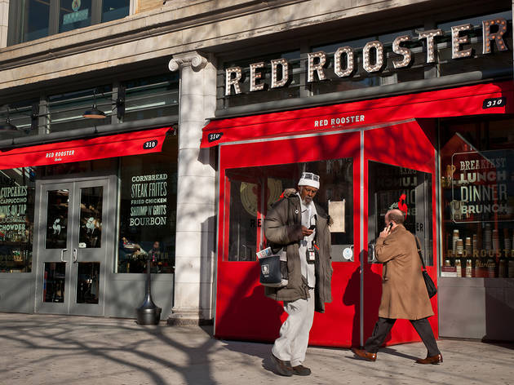
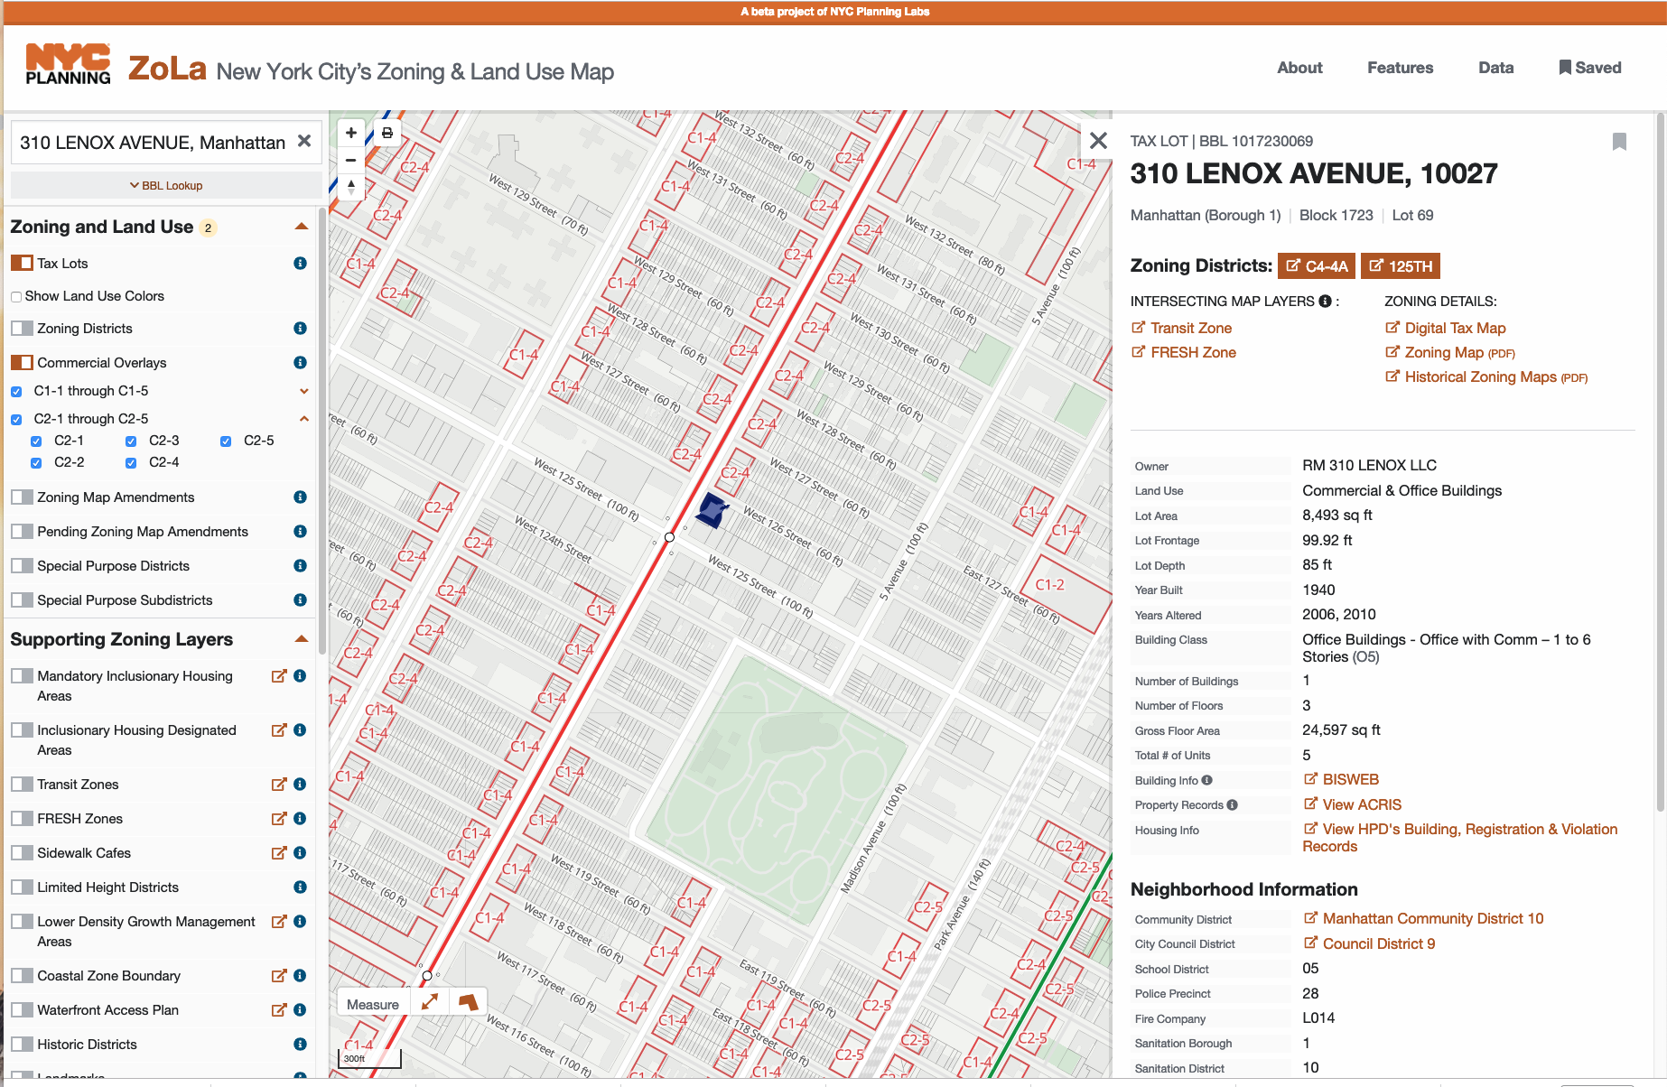
Appendix Red Rooster: 310 Lenox Avenue BSA Special permit Case study Summary
Two years to obtain BSA Special Permit – required for dancing in C4-4A.
Red Rooster hired attorneys, sound consultants, fire consultants, architects, engineers, and contractors.
Constructed two cellar waiting areas to comply with UG 12 requirements of 4 sq. ft. per person - non-income producing.
Multiple hearings and meetings with BSA over two year period.
BSA decided that is should act as a superseding fire safety regulator imposing endless reports, inspections, and studies - all for allowing a few dancers and being within 100 feet of a residential district.
Permit effective for only three years.
Only two other establishments have currently active BSA Special Permits allowing dancing.
Other Restaurants up Lenox Avenue are in no-dancing Use Group 6 zones.
Notes:
The Red Rooster is an important Case Study as to its BSA Special Permit. It is very expensive and time consuming to obtain BSA Special Permits
Which is why only two other establishments in NYC have active Special Permits to allow dancing. You may review these slides on your own time.
This is an unusual case study since so much is available via FOIL and the contradictions of music and dancing zoning were confronted.
I am not the attorney for Red Rooster and my knowledge derives exclusively from documents obtained by Freedom of Information Law (FOIL) requests.

Slide 74
The Red Rooster Saga - legalizing dancing
Notes:
[Not in live presentation.]
[________________]
I do not represent Red Rooster. They may not wish to have their application reviewed. Based on public records. I love the restaurant.

Slide 75
Red Rooster: 310 Lenox Avenue – C4-4a. Up Lenox avenue, Use Group 6 Zoning – No dancing
Notes:
[Not in live presentation.]
Summary: Red Rooster is in C6-4A with dancing allowed with BSA Special Permit. Surrounding area is Use Group 6.

Slide 76
Red Rooster: 310 Lenox Avenue – C4-4a.
“Ginny’s does not have a dance floor and there is no designated area for dancing activities. However, Ginny’s does not prohibit its patrons from dancing either during dinner or its gospel performances.”
Did not increase number of patrons in First Floor Restaurant or Cellar Club.
Did not change the noise emanating from either – and both allowed to have live performances.
Notes:
[Not in live presentation.]
[ Number of patrons not increase and noise emanating did not change and live music did not increase]

Slide 77
Red Rooster: 310 Lenox Avenue – C4-4a. Up Lenox avenue, Use Group 6 Zoning – No dancing
“Although the Proposed Use requires a special permit in accordance with Section 73-244 of the Zoning Resolution, it is important to note that both Use Group 6A Eating and Drinking Establishments (i.e., including those that have music for which there is no cover charge and no specified show times) and Use Group 6C Eating and Drinking Establishments (i.e., including those that have musical entertainment but not dancing with a capacity of 200 persons or less) are permitted by the Zoning Resolution as a matter of right. We also note that but for the proximity of the Site to a residential district boundary (i.e., the Site is within 100 feet of a residence district boundary), the proposed Use Group 12A Eating and Drinking Establishment would be an as-of-right use pursuant to the Zoning Resolution. ”
Notes:
[Not in live presentation.]
Red Rooster explains why it needed a Special Permit – the cellar (not the Ground Floor) was within 100 feet of a residential district, which under the ZR would require a Special Permit if there is to be any dancing.

Slide 78
Red Rooster: 310 Lenox Avenue BSA Special permit Case study
Two years to obtain BSA Special Permit – required for dancing in C4-4A.
Red Rooster hired attorneys, sound consultant, fire consultants, architects, engineer, and contractors.
Constructed two cellar waiting areas to comply with UG 12 requirements of 4 sq. ft. per person - non-income producing.
Multiple hearings and meetings with BSA over two year period.
BSA decided that is should act as a superseding fire safety regulator imposing needless reports, inspections, and studies - all for allowing a few dancers.
Permit effective for only three years.
Only two other establishments have currently active BSA Special Permits allowing dancing.
Other Restaurants up Lenox Avenue are in no-dancing Use Group 6 zones.
Notes:
[Not in live presentation.]
Red Rooster – Special Permit duration is only 3 years. Very expensive and time consuming to obtain BSA Special Permit which is why only two other establishments in NYC have Special Permits to allow dancing.

Slide 79
Red Rooster: Certificate of occupancy Still use group 6, not use group 12
Notes:
The Red Rooster still has not amended its Certificate of Occupancy to show Zoning Use Group 6, despite receiving a Special Permit from the BSA.
The Red Rooster – Special Permit duration is only 3 years.
Very expensive and time consuming to obtain BSA Special Permit which is why only two other establishments in NYC have Special Permits to allow dancing.

Slide 80
Red Rooster: The Irony. Other Venues on Lenox avenue are zoned for “NO Dancing”.
Notes:
[Not in live presentation.]
This is an ironic statement from the Red Rooster in support of its Special Permit.
Other venues neighboring Red Rooster are in Use Group 6 where dancing is not allowed.
“The Red Rooster Restaurant seeks to re-establish and re-capture part of Harlem’s history and culture through its “supper club” experience. Red Rooster’s proposal builds upon a central ideal that flourished during the Harlem Renaissance: the view of neighborhood eateries as extended dining rooms for social interaction and artistic enjoyment. Few existing venues provide this type of entertainment that Harlem was once known for.”

Slide 81
1932 Harlem Nightlife E. Sims
Red Rooster -downtown
Notes:
[Not in live presentation.]
This famous 1932 “Nightclub Map of 1930s Harlem) by E. Sims Campbell shows the Nightlife scene on upper Lenox Avenue during the Harlem Renaissance – now zoned Use Group 6 – dancing not allowed. The Red Rooster would be further down Lenox on the upper left. “The only important omission is the location of the various speakeasies, but since there are about 500 of them you won’t have much trouble,” the map instructs readers. Original at Yale University.

Slide 82
Resources/Links zortmusic.com/nightlife/
Entire Zoning Resolution 8683 Pages
Zoning Resolution Dancing/Music Excerpts 155 Pages
CPC ULURP Chart
CPC Use Group Chart
Red Rooster Documents (Zort Site)
1989 Report at CPC Website.
1989 CPC Report at Zortmusic.con.
https://tinyurl.com/DancingMapNYC
Wei, Whitney (2016), Clubbed to Death: The Decline of New York City Nightlife Culture Since the Late 1980s, Columbia University Bachelor’s Thesis.
Notes:
This concludes the extended submission as edited and . Download a pdf version of this PowerPoint Presentation at zortmusic.com/nightlife/. Also, available at that site are source documents.
If reviewing using PowerPoint, you may need to right-click on the link; then select HyperLink; and then select “Open HyperLink”.

Slide 83
Finish
Notes:
So, as someone who does not practice and appear before these agencies on a regular basis, I would ask if I have misstated or overstated anything here – in particular, Mr. Bookman, this is your expertise. Have I misled the assembled here in any way?
Thank you.

